Slide 1
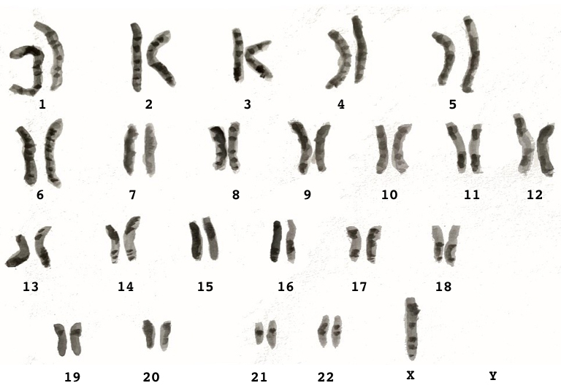
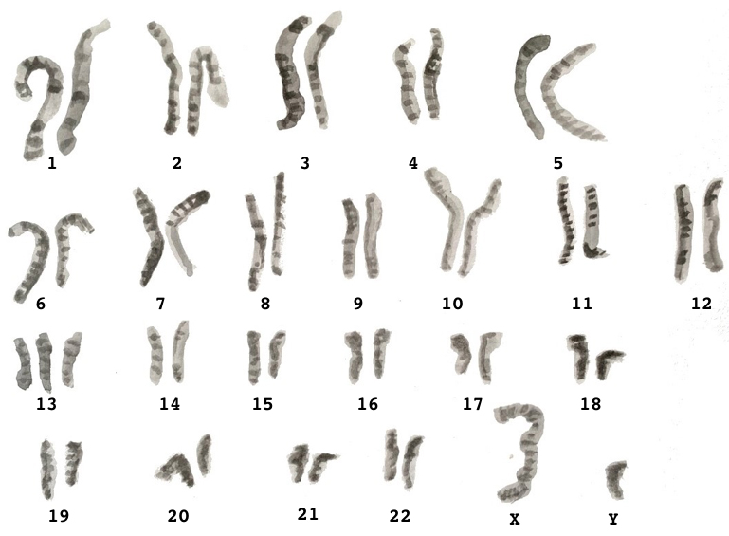
Turner syndrome
(45, X0)
Trisomy 13

Slide 2
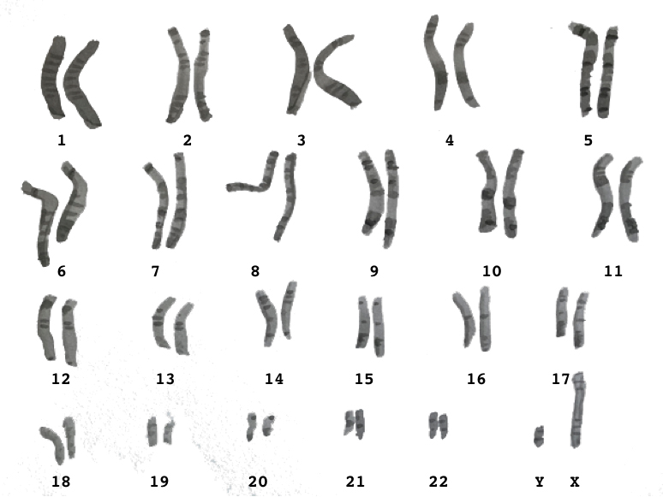
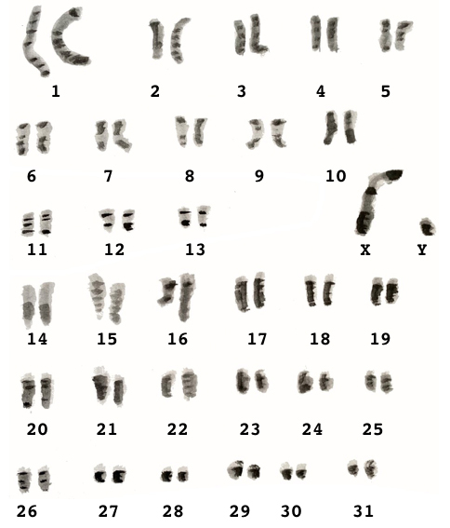
male human being
horse

Slide 3
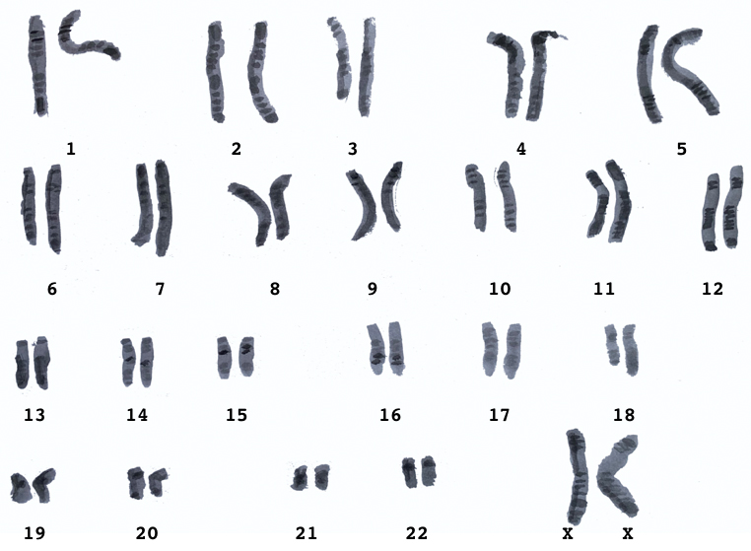
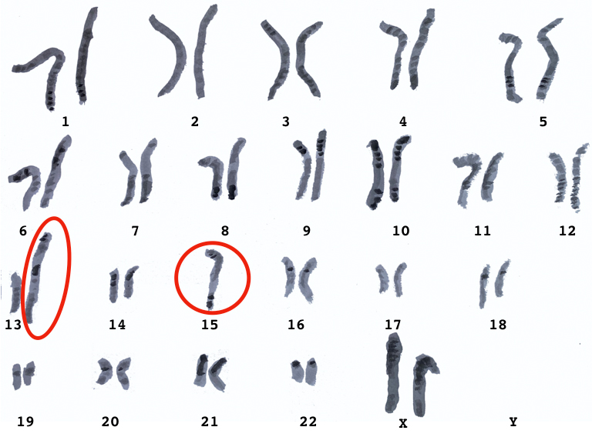
Translocation (= a whole chromosome
or a chromosomal segment
has been moved to another location)
female human being

Slide 4
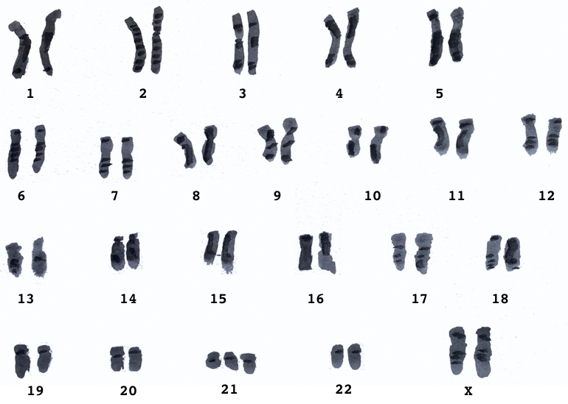
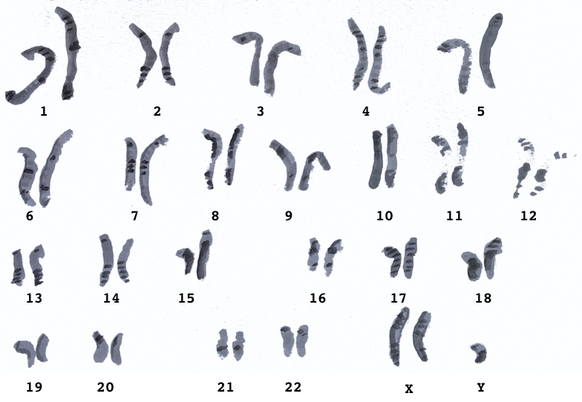
Down syndrome/
Trisomy 21
Klinefelter syndrome
(47, XXY)

Slide 5
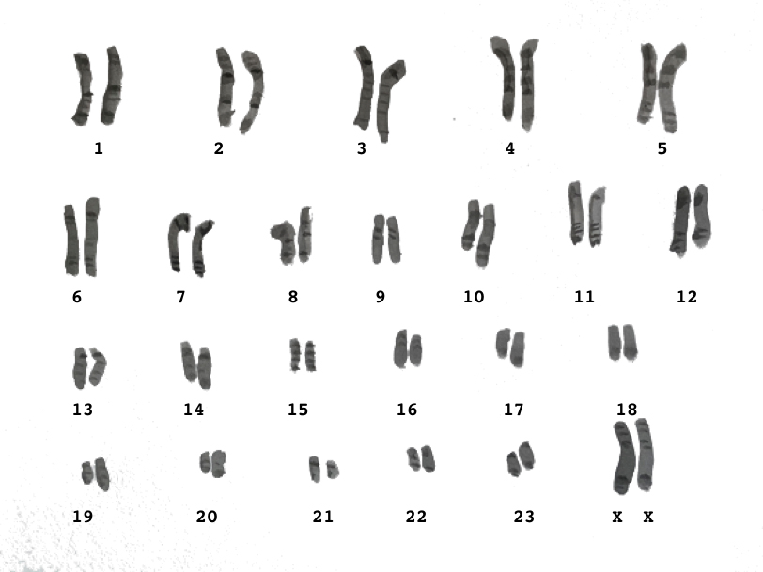
fruit fly
female chimpanzee

Slide 6
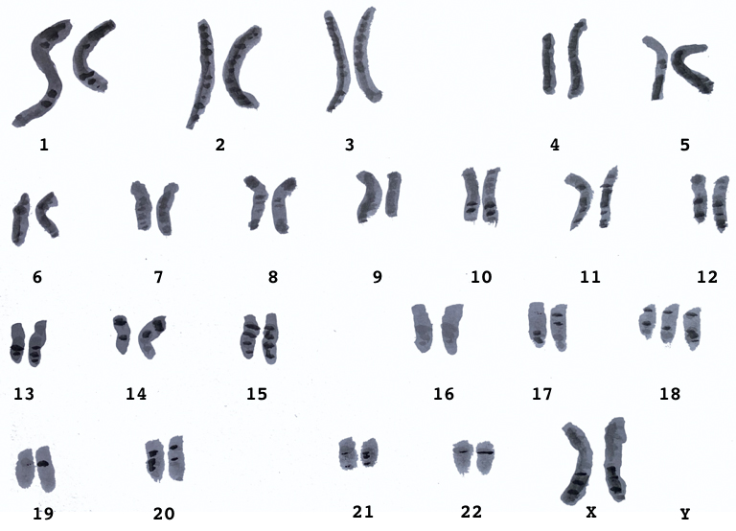
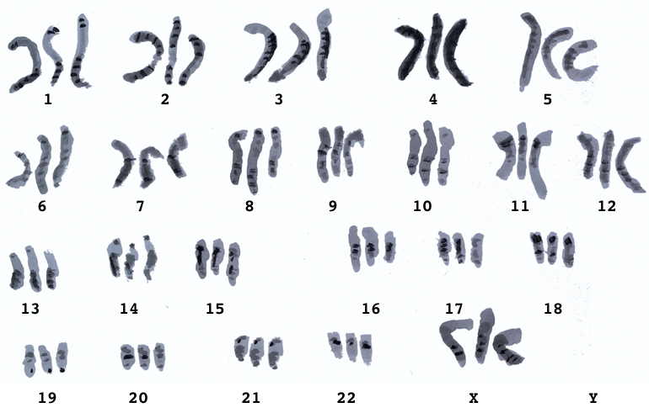
Triploidy (= three sets of chromosomes;
responsible for 12 % of
spontaneous abortions
Trisomy 18

Slide 7
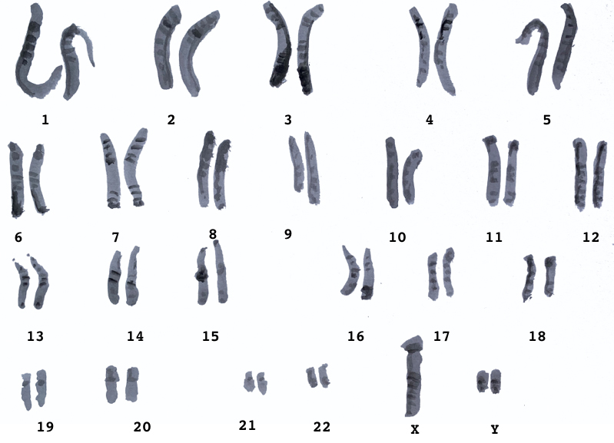
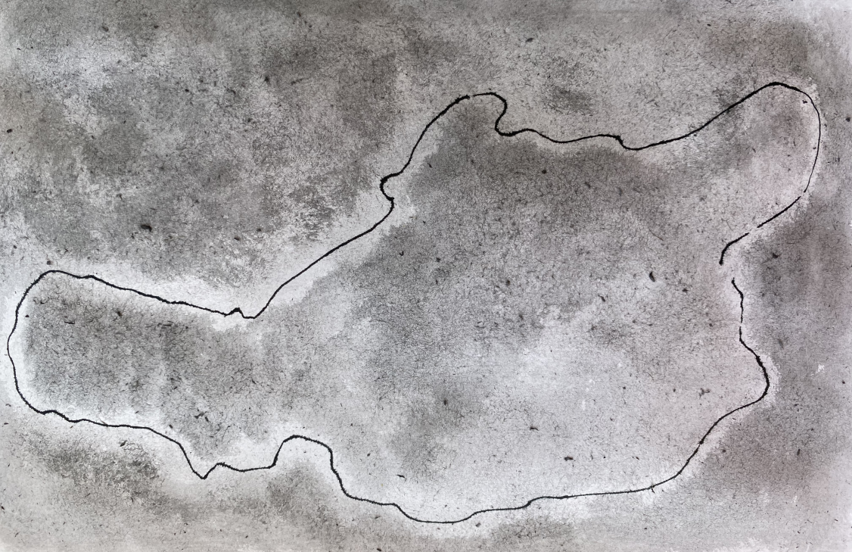
XYY-syndrome
bacterial chromosome

