Slide 1
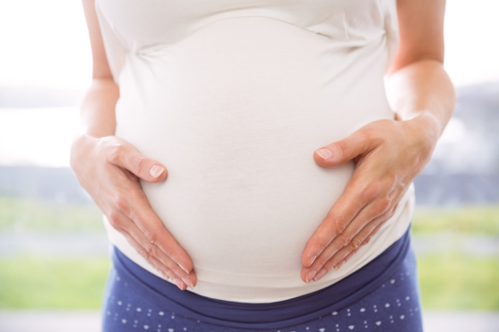
β-carotine, an orange substance that gives carrots their
colour, is required by the human body to make vitamin A.
Rice does not contain any β-carotine.
How can we provide people who eat mainly rice
with β-carotine?
Will my baby suffer from the same genetic disease
my grandfather died of?
Scientists have genetically modified rice plants
so that they produce large amounts of β-carotine.
Genetic testing allows the diagnosis of
hereditary diseases prenatally
(= when the fetus is still in the womb).

Slide 2
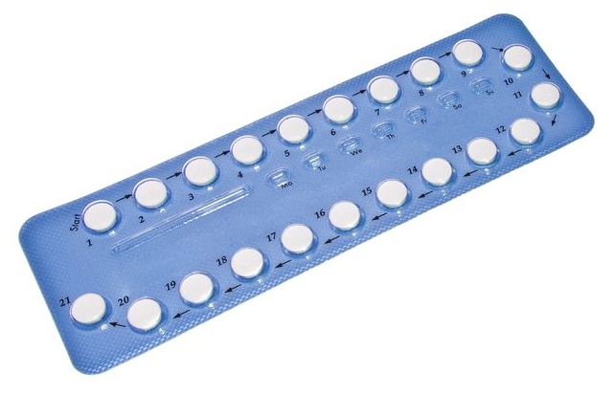
Birth control pills increase the risk of
thrombosis (= a life-threatening, sudden blockage
of a blood vessel).
Before using hormonal contraceptives, I need to know
whether I carry in my genes an enhanced risk
of thrombosis. How can I find out?
The son of our neighbours has been diagnosed
with leukemia (= blood cancer).
Can he be cured of the disease?
A gene therapy has been developed that uses
genetically modified immune cells of the
patient to kill off the cancer cells. Emily Whitehead
was the first patient to receive this therapy in 2011
at the age of 6 and has
been free of cancer ever since.
A genetic test can reveal a genetic predisposition
for thrombosis.
Please insert a current picture of Emily Whitehead

Slide 3
There are around 250 000 cases of juvenile diabetes
in Germany.
Where do we get the huge amounts of insulin from
needed to treat all patients?
How can the police prove that the prime suspect
was at the crime scene?
Scientists can generate a so-called
genetic footprint from material left behind
by a person at a crime scene,
thereby helping to convict the criminal.
Fungi have been genetically engineered to produce
virtually unlimited quantities of human insulin.

Slide 4
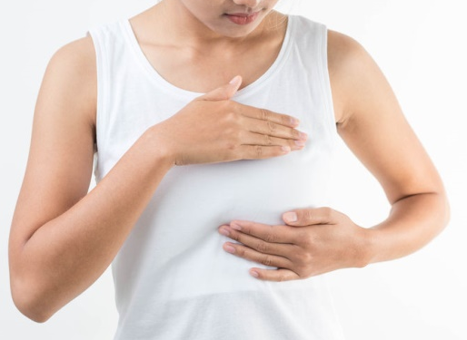
Both my grandmother and my aunt developed
breast cancer early in life.
Do I carry a genetic predisposition for
breast cancer?
I wonder whether my child is really my child or
whether my child carries the genes of another man.
A genetic test can detect mutations in breast cancer
genes. If a woman gets tested, she will either learn
that her risk of developing cancer is not enhanced,
or she will have to cope with the fact that
she carries the same mutation that
caused breast cancer in her relatives.
Paternity tests use genetic fingerprinting to either
prove or disprove biological fatherhood.

