Slide 1
Bilingualer Geographieunterricht
REALSCHULE BAYERN
19.07.2022 Stefanie Hartl

Slide 2
AGENDA
AGENDA
A Ausgewählte Unterrichtsmaterialien
Aral Sea – Interviewing pictures
Illegal immigrants in the USA – Drawing a life line
Illegal immigrants in the USA - Mystery
El Niño – an abnormal weather phenomenon
Sao Paolo - city of contrasts: Lernjob
B Fragen, Wünsche, Anregungen

Slide 3
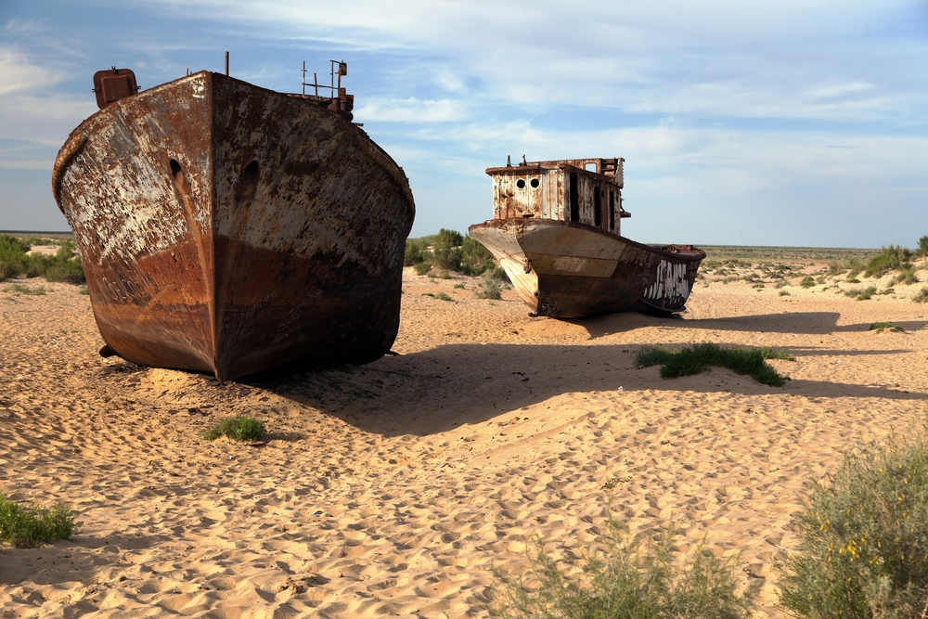
A Ausgewählte Unterrichtsmaterialien
1. Aral Sea – Interviewing pictures
Leading question: „Where was this picture taken?“
© Clipdealer

Slide 4
A Ausgewählte Unterrichtsmaterialien
1. Aral Sea – Interviewing pictures
Die Methode „Interviewing pictures“ setzt sich aus zwei Teilen zusammen
1. Teil: picture description / wh - questions / making assumptions and suggestions / finding a heading,… in Partner – oder Einzelarbeit
2. Teil: Austeilen von Informationskärtchen zum Bild (z. B. drei pro Person)
in Gruppen- oder Partnerarbeit herausfinden, wo das Bild aufgenommen wurde
eine Bildüberschrift formulieren

Slide 5
A Ausgewählte Unterrichtsmaterialien
Information cards: Aral Sea
The picture was taken on the 46th Parallel. | The average annual rainfall is about 140mm. | This area is located in Asia.
Today you can only admire several fish in a museum. | The area of this former lake was located in Kazakhstan and Uzbekistan. | In the sixties most people here made their living from fishing.
Even the area of a harbor nearby has dried out. | The lake is fed by two main feeder rivers - The Amudarya and the Syrdarya. | The elevation is 60m.
Winters are very cold and windy. | There you can find continental climate. | The hottest month is July.

Slide 6
A Ausgewählte Unterrichtsmaterialien
Illegal immigrants in the USA – Drawing a life line
Vorgehensweise:
Schülerinnen und Schüler erhalten ein Arbeitsblatt mit chronologisch geordneten Aussagen zu einem bestimmten Sachverhalt.
Sie benötigen auch ein Achsenkreuz, wobei die x-Achse die Zeitleiste und die y-Achse die positiven bzw. negativen Gefühle der Hauptpersonen repräsentieren.
Zu jedem Ereignis wird nun die positive, negative oder neutrale Gefühlslage mit einem Kreuz auf der y-Achse versehen, das am Ende zu einer Kurve verbunden wird.

Slide 7
A Ausgewählte Unterrichtsmaterialien
Ziel: Lebensgefühl der Hauptperson mit Höhen und Tiefen wird dargestellt
Variante:
Man kann auch alle Lebensliniendiagramme sichtbar aufhängen und miteinander vergleichen.
Als Vertiefung können einzelne Aussagen von Personen nach Fertigstellung des Diagramms dem Zeitpunkt zugeordnet werden, wann sie wahrscheinlich getroffen worden sind.

Slide 8
Illegal immigrants in the USA – Drawing a life line
A Ausgewählte Unterrichtsmaterialien
1 | 1989 | Tijuana is a city near the border to the USA. Candido was born here. His family is very poor.
2 | 1994 | The Rio Bravo or Rio Grande (the American name for it) is shallow enough for Mexicans to cross the river easily.
3 | 2003 | Spanish has become the main language in a lot of communities in the south of the USA.
4 | 2008 | Human rights organisations want people to pay more attention to the living conditions of illegal immigrants in the USA.
5 | 2010 | On May 28, 2010, a dozen border patrol agents beat Hernández Rojas, a father of five children, who wanted to cross the border.
6 | 2014 | President Obama announced that the immigration system of the USA had been broken for decades. And while the American government waited to act, millions of undocumented immigrants were living in the shadows: Those who wanted to pay taxes and play by the same rules as everyone else had no chance to live legally.
7 | 2015 | More and more white communities in the USA want to have a wall around their houses.
8 | 2016 | Although the economy has grown in recent years the gap between rich and poor people in Mexico is getting larger. About 50 % of the inhabitants live in poverty. Candido can´t find a job in Mexico.
9 | 2017 | The border to the USA is already secured with double or even triple fencing. The border patrol is equipped with portable watch towers.
10 | 2018 | In California there are about 2.3 million illegal immigrants.
11 | Jan. 2019 | Candido marries a Mexican girl called Selma.
12 | Mar. 2019 | Candido makes the decision to cross the tortilla curtain, find work in the USA and live a good life with his wife Selma.
13 | Apr. 2019 | Candido borrows some money to start their journey to California.
14 | Nov. 2019 | Candido and Selma arrive in the USA. They live in a canyon where they are protected from heavy rainfall and the cold.
15 | 2020 | Candido can´t find a job. They are not able to rent an apartment.
16 | 2021 | Selma is pregnant.

Slide 9
A Ausgewählte Unterrichtsmaterialien
3. Illegal immigrants in the USA - Mystery
Vorgehensweise:
Bearbeitung in Gruppen
Eine Leitfrage.
Informationskärtchen, z. B. in Briefumschlag
Zusätzliche Materialien, wie Bilder, Zeitungsausschnitte, Diagramme,…
Zunächst Schaffen eines Überblicks (Informationen auf dem Tisch auslegen), dann Identifizieren von unbekannten Wörtern.
→ dictionary work
Hinweise an die Klasse:
Nicht jede Information ist wichtig.
Das sinnvolle Ordnen der Informationskärtchen ist wichtig.
Topographische Informationen sollen mit Hilfe des Atlas verortet werden.

Slide 10
A Ausgewählte Unterrichtsmaterialien
3. Illegal immigrants in the USA - Mystery
Ergebnissicherung:
mündlich bzw. schriftlich
auf Plakat
Ziel: Die Leitfrage soll unter Mobilisierung von Vorwissen umfassend beantwortet werden.

Slide 11
3. Illegal immigrants in the USA - Mystery
A Ausgewählte Unterrichtsmaterialien
Can Candido and Selma start a new life in California?
Candido makes the decision to cross the tortilla curtain, find work in the USA and live a good life with his wife Selma. | The Rio Bravo or Rio Grande (the American name for it) is shallow enough for Mexicans to cross the river easily. | San Diego, a city in California, offers a lot of jobs.
More and more communities want to have a wall around their houses. | They have already run out of food and just one bottle of water is left on their way to the border. | The 34-year-old man was told about the booming city of San Diego by his neighbor, who has already worked in the USA.
Candido is hit by a car on a busy road in San Diego and severely injured. His hip is damaged, so he won´t be able to work for weeks. | Injuries take much longer to heal without medical treatment. Candido can’t afford to see a doctor. | In California there are about 2.3 million illegal immigrants.
Most illegals leave at noon without being hired. You have to try again the next day. | Candido was born and brought up in Tijuana. | Selma becomes pregnant. But they cannot afford to see a doctor or go to a hospital.
Sweatshops are small factories near the border where imported parts of goods are assembled and sent back to the USA. | After crossing the border for the first time a border patrol catches them and sends them back. | Officially the city of Tijuana has about 1.5 million inhabitants.
The border between the USA and Mexico is called “the Tortilla Curtain”. | There are big halls where illegal immigrants can go to in the mornings and if you are lucky, one of the white people will offer you a job for one day. If you work hard enough, you might be hired for another day or even two days. | Candido borrows some money to start their journey to California.
After some time they try to cross the border again because in Mexico there aren´t a lot of well-paid jobs. You could work in a sweatshop where you are treated like a slave. | Candido gets married to a 17-year- old girl called Selma in his hometown after his divorce from his first wife. | Right at this moment they think they are safe living in the canyon outside the city of San Diego. Candido just needs to find work.
Their dream is to have their own apartment in an American city and be part of the society. | In a sweatshop you earn about 40-70 dollars a week. | In the canyon they are protected from heavy rainfall and the cold. And nobody can find them.
Selma scrubs the copper statues in a rich man´s house without wearing gloves. The skin of her hands is burned. | His wife has to start working. | Although the economy has grown in recent years, the gap between rich and poor people in Mexico is getting larger. About 50 % of the inhabitants live in poverty.
Spanish has become the main language in a lot of communities in the south of the USA. | The border to the USA is secured with double or even triple fencing. The border patrol is equipped with portable watch towers. | Human rights organisations want people to pay more attention to the living conditions of “indocumentados” in the USA.
Selma misses her family in Mexico. She wants to talk to her mother about the baby. | Candido tries to rent an apartment for just some days but he is robbed, so all the money they saved is gone. | The second time they try to cross the border it works. Candido and his beautiful wife arrive in California.

Slide 12
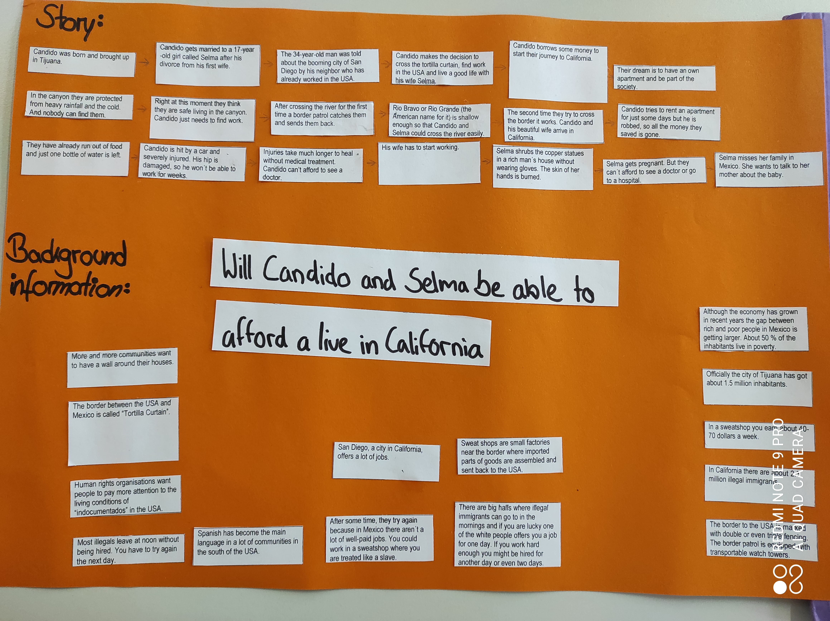
A Ausgewählte Unterrichtsmaterialien
Illegal immigrants in the USA – Mystery
Schülerbeispiel:

Slide 13
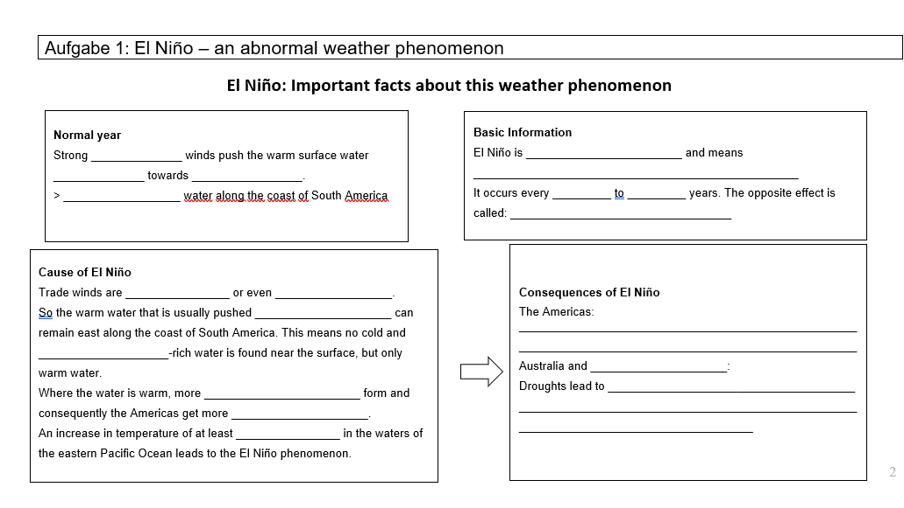
4. El Nino – an abnormal weather phenomenon

Slide 14
A Ausgewählte Unterrichtsmaterialien
El Niño – an abnormal weather phenomenon
Informationstexte zum Ausfüllen des Arbeitsblattes
können in Gruppenarbeit als placemat bearbeitet werden
können im Klassenzimmer aufgehängt werden
Sicherung erfolgt über das Beschriften eines Diagramms
Weiterführende Aufgabe: Besprechen eines stummen Videos
→ Erklärung des Phänomens in eigenen Worten

Slide 15
A Ausgewählte Unterrichtsmaterialien
Why is it called El Niño?
El Niño means Little Boy or Christ Child in Spanish.
South American fishermen first noticed periods of unusually warm water in the Pacific Ocean in the 1800s.
The full name they used was El Niño de Navidad, because El Niño typically takes place in December, around Christmas time.
How is El Niño caused?
The sun warms the water near the equator.
Normally there are trade winds, which push that warm water westward. During El Niño, those trade winds aren’t strong, or they are even reversed which lets the warm water that is usually found in the western Pacific, flow east.
This warm water displaces the cooler water that is normally found near the surface of the eastern Pacific.
In El Niño years, ocean waters along South America and California warm more than usual.
An increase of temperature of at least 0.9 F (0.5 C) in the waters of the eastern Pacific Ocean near the equator is called El Niño.
What is El Niño?
When we notice different weather conditions, we usually think of what’s in the air. But did you know that a lot of what happens in the air is due to the temperature of the oceans?
El Niño is an abnormal weather phenomenon which is caused by the warming of the Pacific Ocean near the equator, off the coast of South America. It can create more clouds and consequently more rain.
Although El Niño does not occur in a perfectly regular pattern, it happens every 2 to 7 years.
Following El Niño, the opposite phenomenon occurs, called La Niña. During La Niña, the eastern Pacific Ocean is cooler than usual around the equator.
What are the consequences of El Niño?
Many rain clouds form over this warm part of the ocean and move inland, so you get more rain than usual in South and Central America and in the United States. The consequences of increased rainfall across the southern parts of the US and in Peru are destructive flooding. This can lead to bad hygiene and so to serious diseases.
El Niño also has a strong effect on marine life off the Pacific coast. During normal conditions the water there is cold and nutrient-rich. During El Niño, upwelling weakens or stops altogether. Without the nutrients from the deep, there are fewer phytoplankton off the coast. This affects fish that eat phytoplankton and, in turn, affects everything that eats fish.
The warmer waters can also bring tropical species, like yellowtail and albacore tuna, into areas that are normally too cold.
El Niño also affects the weather in many other parts of the world, such as bush fires in Australia. High temperatures also lead to reduced crop yields or the death of cattle.

Slide 16
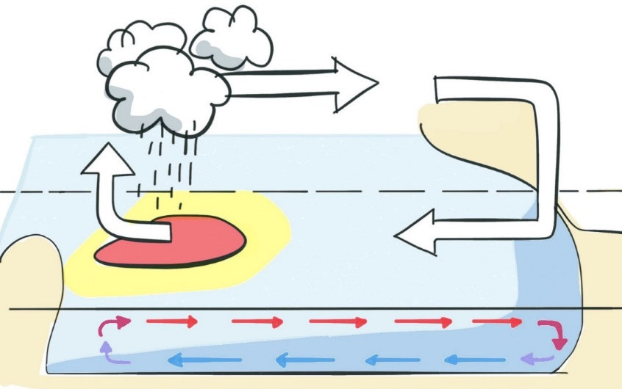
A Ausgewählte Unterrichtsmaterialien
Normal conditions
More clouds form and more rain falls in regions where the ocean is warm. Areas near the equator are heated up by the sun, resulting in warm water on the surface of the Pacific Ocean. Under normal conditions, the warm surface water is pushed from South America westward toward Indonesia by strong trade winds. As a result, cooler water from underneath rises up to the ocean surface near South America.

Slide 17
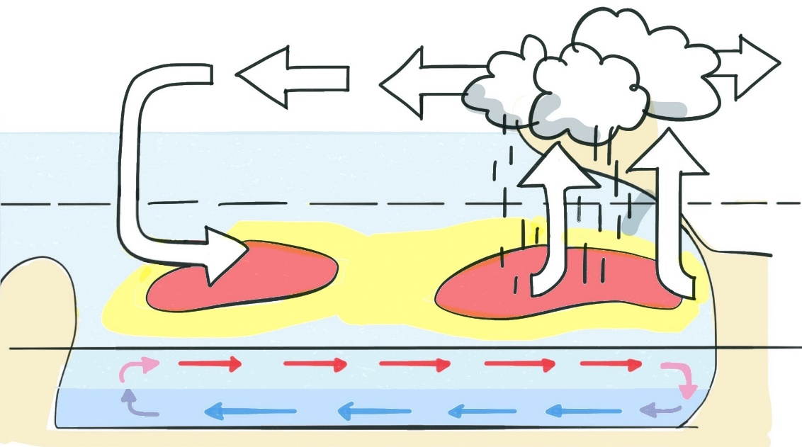
A Ausgewählte Unterrichtsmaterialien
Conditions causing El Niño
If trade winds are weaker than usual, warm water piles up along the coast of South America before moving towards California and Chile. Above these areas of warm water, a great number of rain clouds form. They move inland and dump much more rain in the Americas than usual. At the same time, Australia and Indonesia may suffer drought.

Slide 18
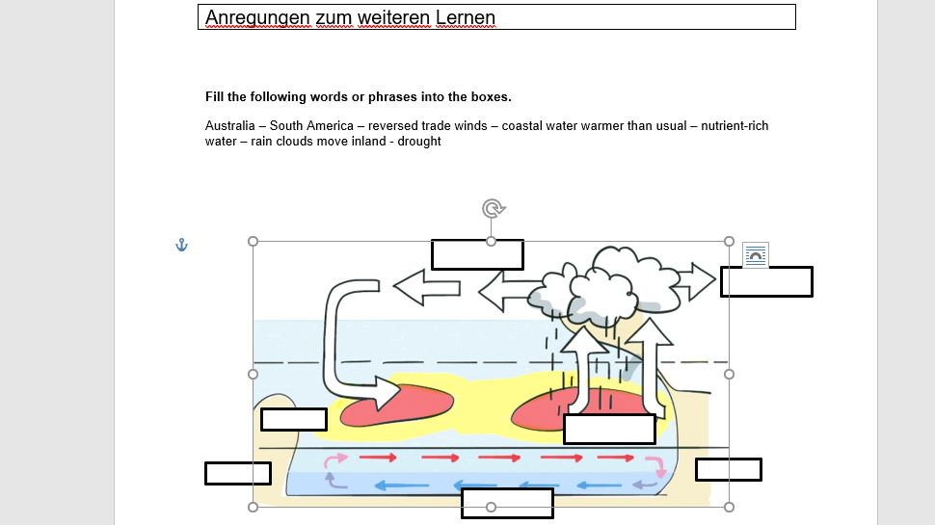
A Ausgewählte Unterrichtsmaterialien

Slide 19
Sao Paolo - city of contrasts: Lernjob
Was ist ein Lernjob?
Zentrales Mittel des eigenständigen Lernens
Ursprünglich von Projekt KOMPASS (KOMPetenz Aus Stärke und Selbstbewusstsein)
Stets nach festem Schema aufgebaut:
Vorderseite: Eyecatcher; soll Neugierde wecken, z. B. Rätsel, Geschichte, Bild,… Fach und Kompetenzerwartungen notiert
Innenseiten: Lernende erhalten Informationen zur Erarbeitung des neuen Themas zu erarbeiten; Aufgaben nicht aufeinander aufbauend; unterschiedliche Aufgabenformate
Randspalten: zusätzliche Informationen: Diagramme, Hintergrundinformation, Bearbeitungshilfen,…
Rückseite: Einsatz zur Rekonstruktion, Reflexion oder Zusammenfassung
Typisches Format: DIN A3 Seite zur A4 gefaltet, Tipp: in Farbe ausdrucken à motivierender für Schüler
A Ausgewählte Unterrichtsmaterialien

Slide 20
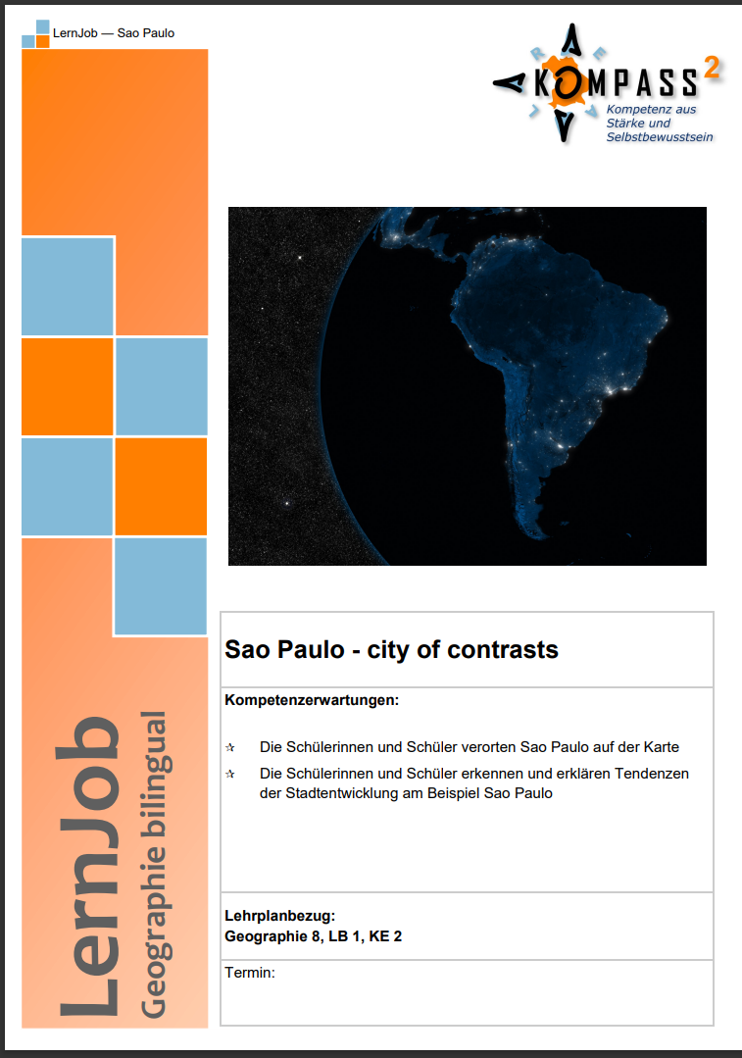
A Ausgewählte Unterrichtsmaterialien

Slide 21
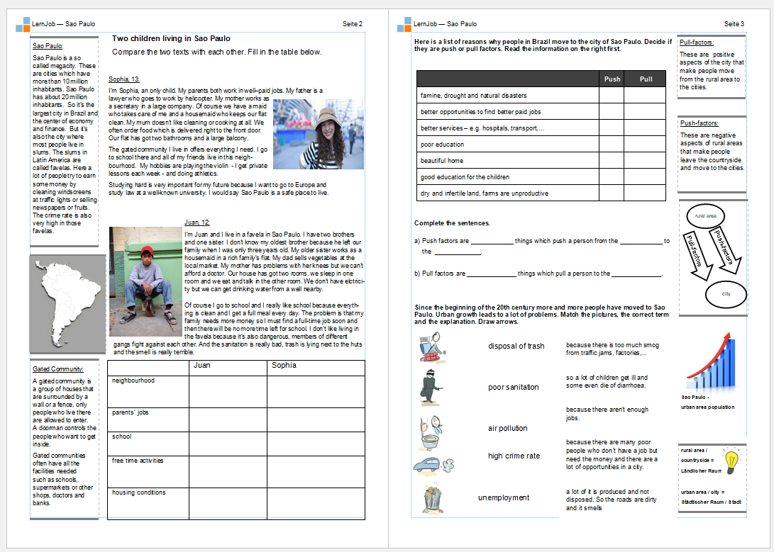
A Ausgewählte Unterrichtsmaterialien

Slide 22
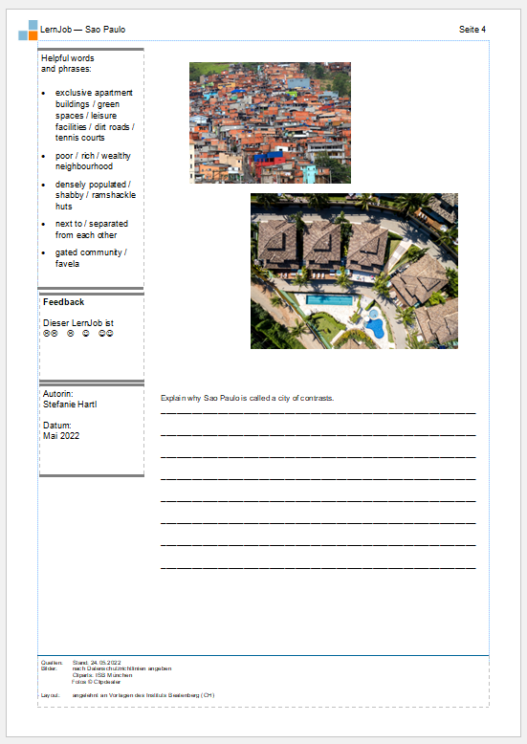
A Ausgewählte Unterrichtsmaterialien

Slide 23
B Fragen, Wünsche, Anregungen
Fragen, Wünsche, Anregungen?

Slide 24
C
Vielen Dank für Ihre Aufmerksamkeit!
StRin Stefanie Hartl
Arbeitskreis Bilingual am ISB Stefanie.Hartl2@schule.bayern.de

