Slide 2
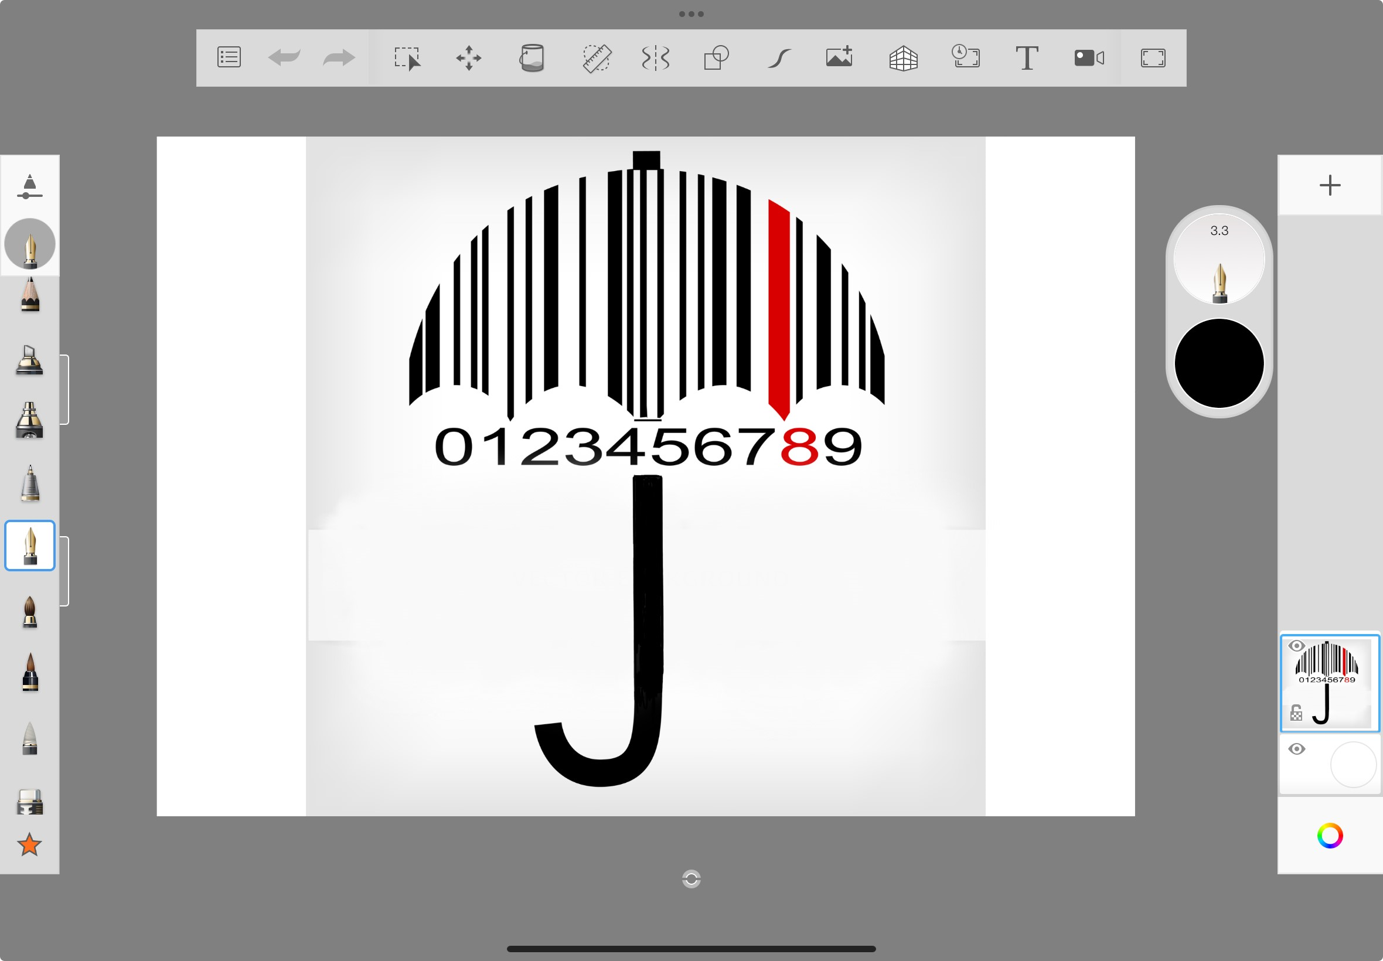

Microsoft bing ImageCreator
Notes:
That is a really nice picture of an umbrella...
I wonder what the numbers mean...

Slide 3
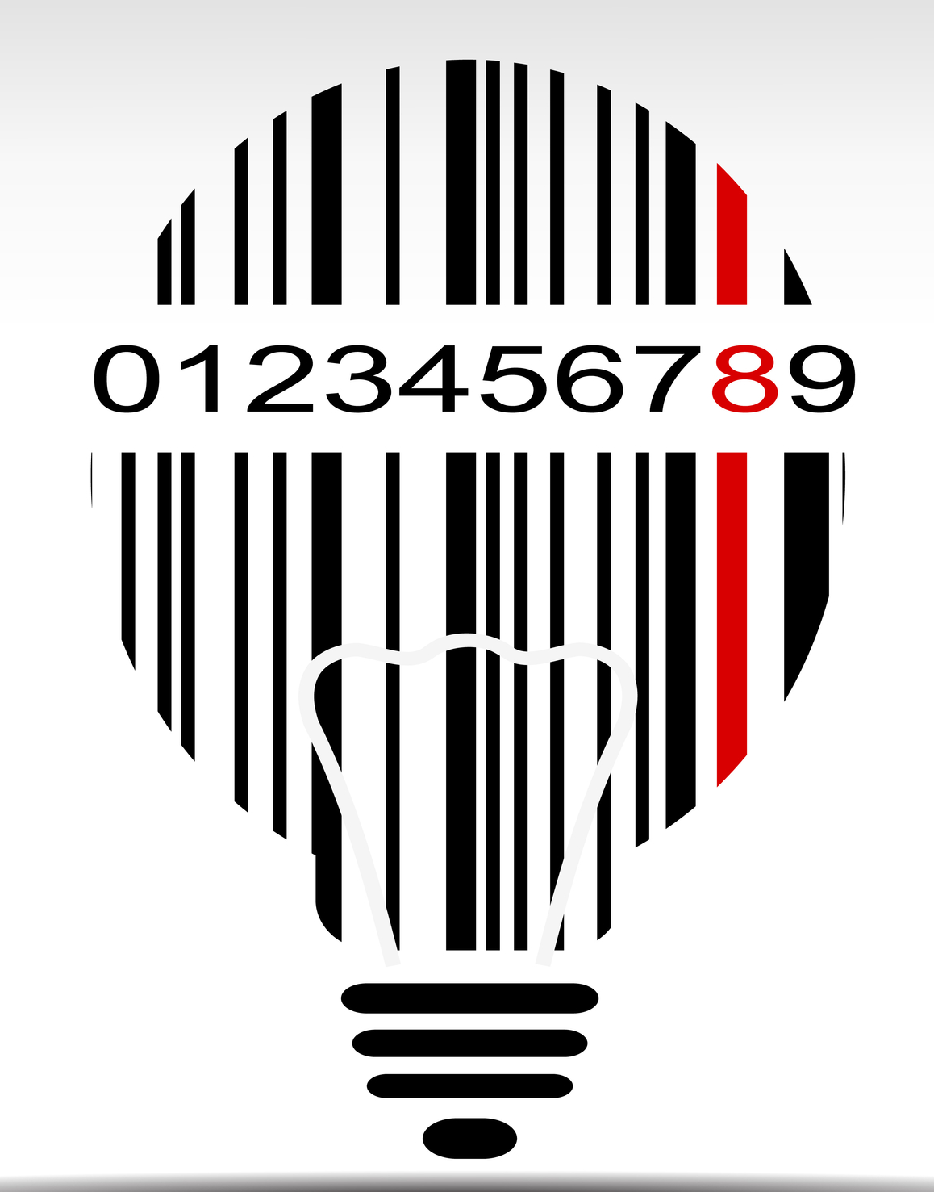

Microsoft bing ImageCreator
Notes:
So this is the BARCODE on the package of ...

Slide 4
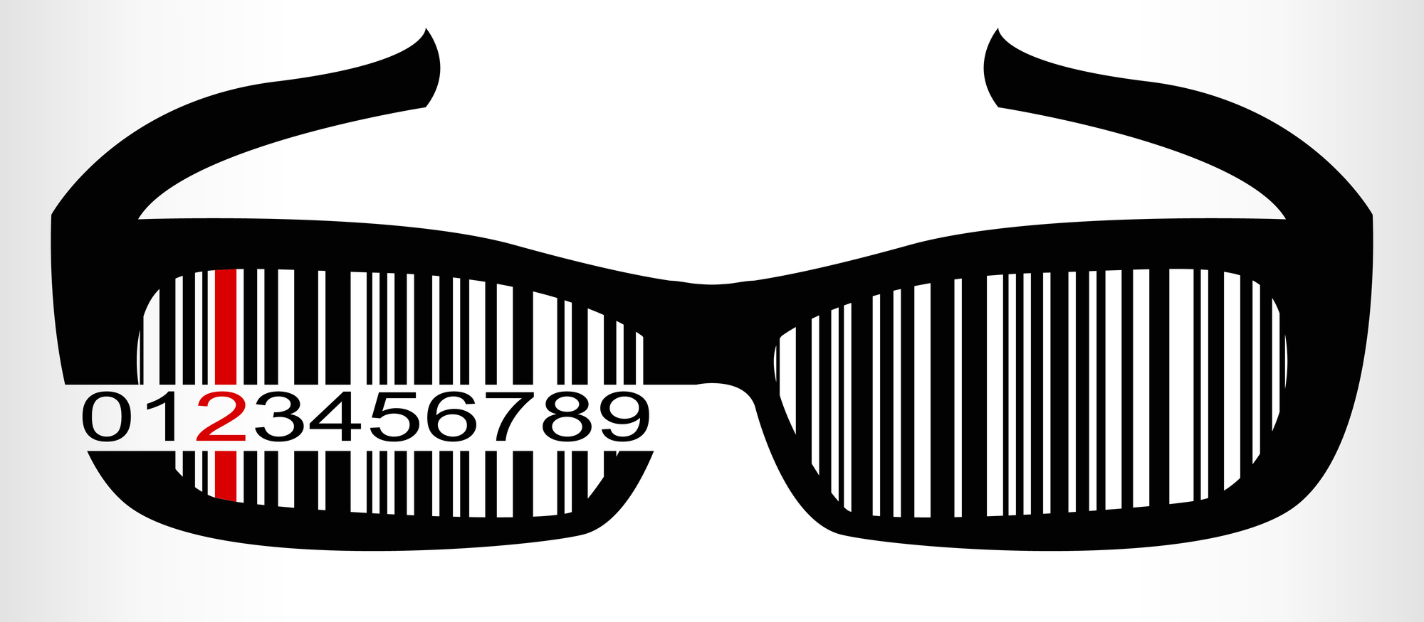

Dieses Bild findest du hier: Pexels | Lizenzdetails Ersteller: Nitin Dhumal | Credit: Foto von Nitin Dhumal Urheberrecht: Nitin Dhumal

Slide 5

Principles of Design
…arrange objects creatively and visually effective
In other words
… help to make art interessting and stop it from being BOOOOOOOOORING
Notes:
in art you always want to keep the attention of the viewer ( the person looking at the art) - if you dont manage, people might find your picture boring...
so some clever people came up with ...

Slide 6
composition
symmetry
asymmetry
Notes:
let's start with an easy on that you - so i guess - have often used without even knowing (being aware of) that you are using it.
HAND OUT WS

Slide 7

Task 1
Decide whether the barcodes presented are symmetrical or asymmetrical.
If symmetrical draw the axis of symmetry in red.
You have got: 3 min.

Slide 8
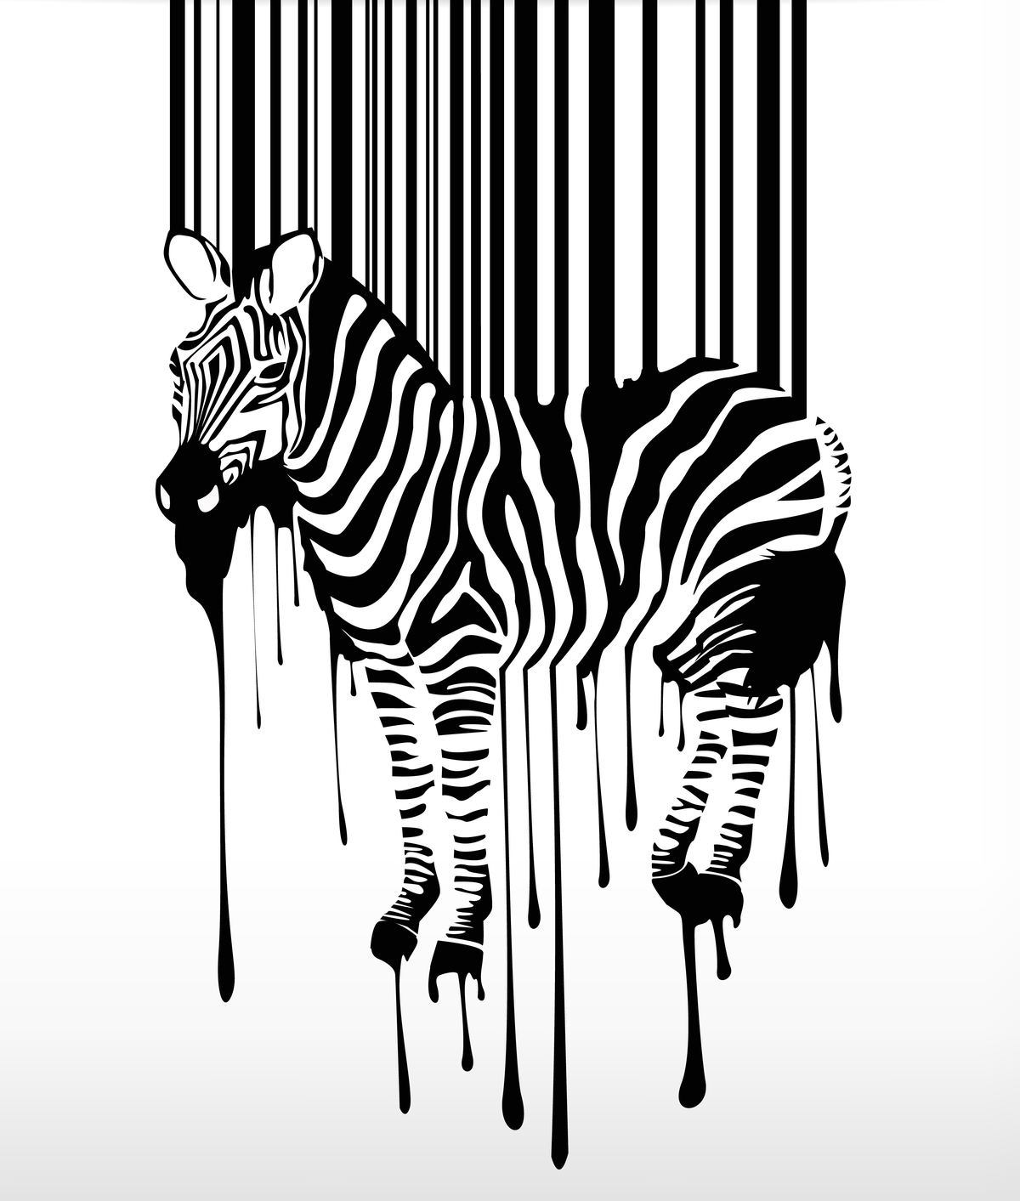
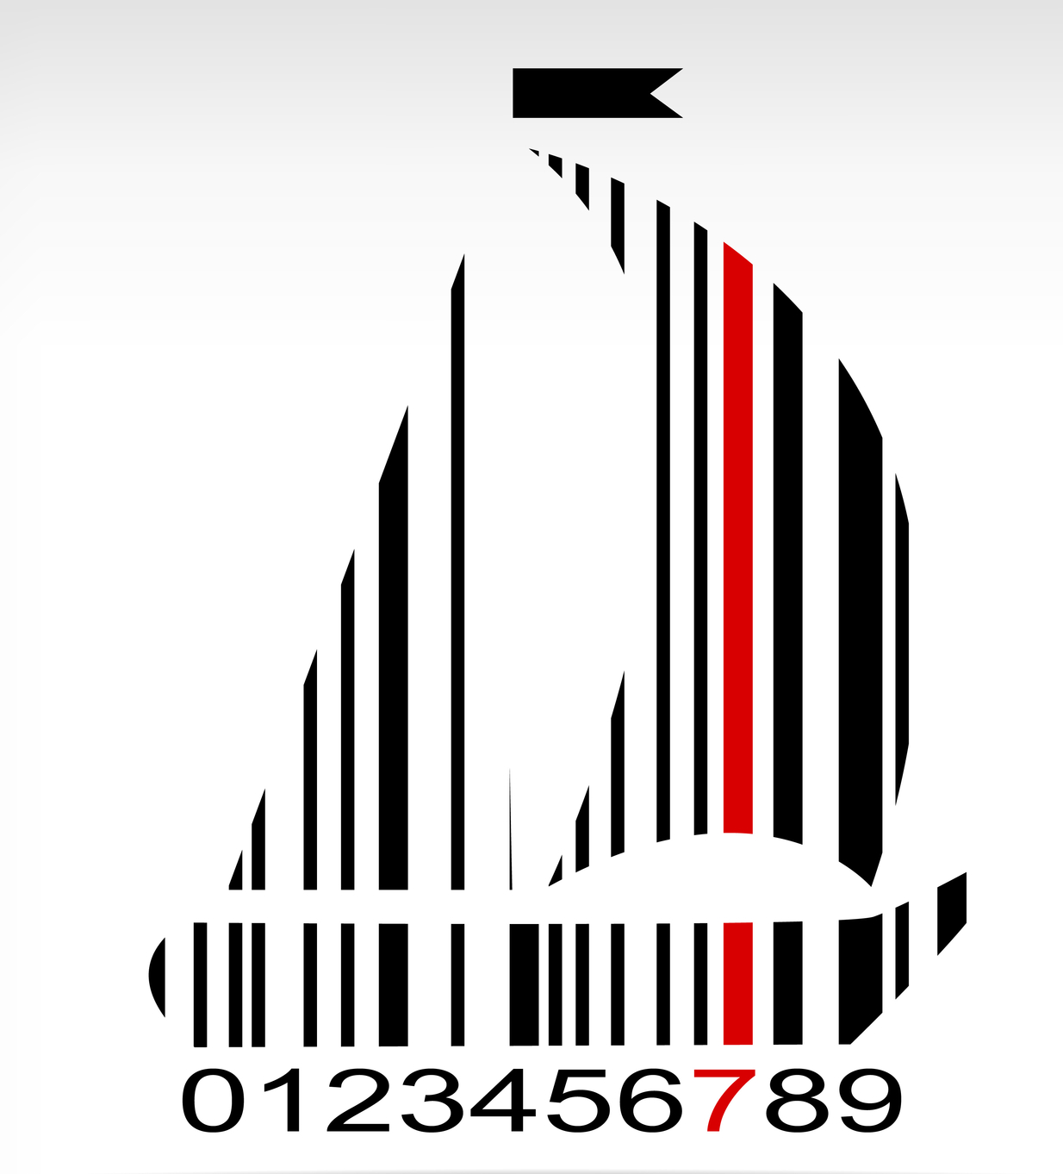


Notes:
here are some more...

Slide 9
Form
serial ordering
cluster
scattering

Slide 10
proportion
rhythm and repetition

Slide 11
Task 2
Match the definitions with the principles
You have got: 3 min.
Notes:
WS part 2 - Lets compare

Slide 12
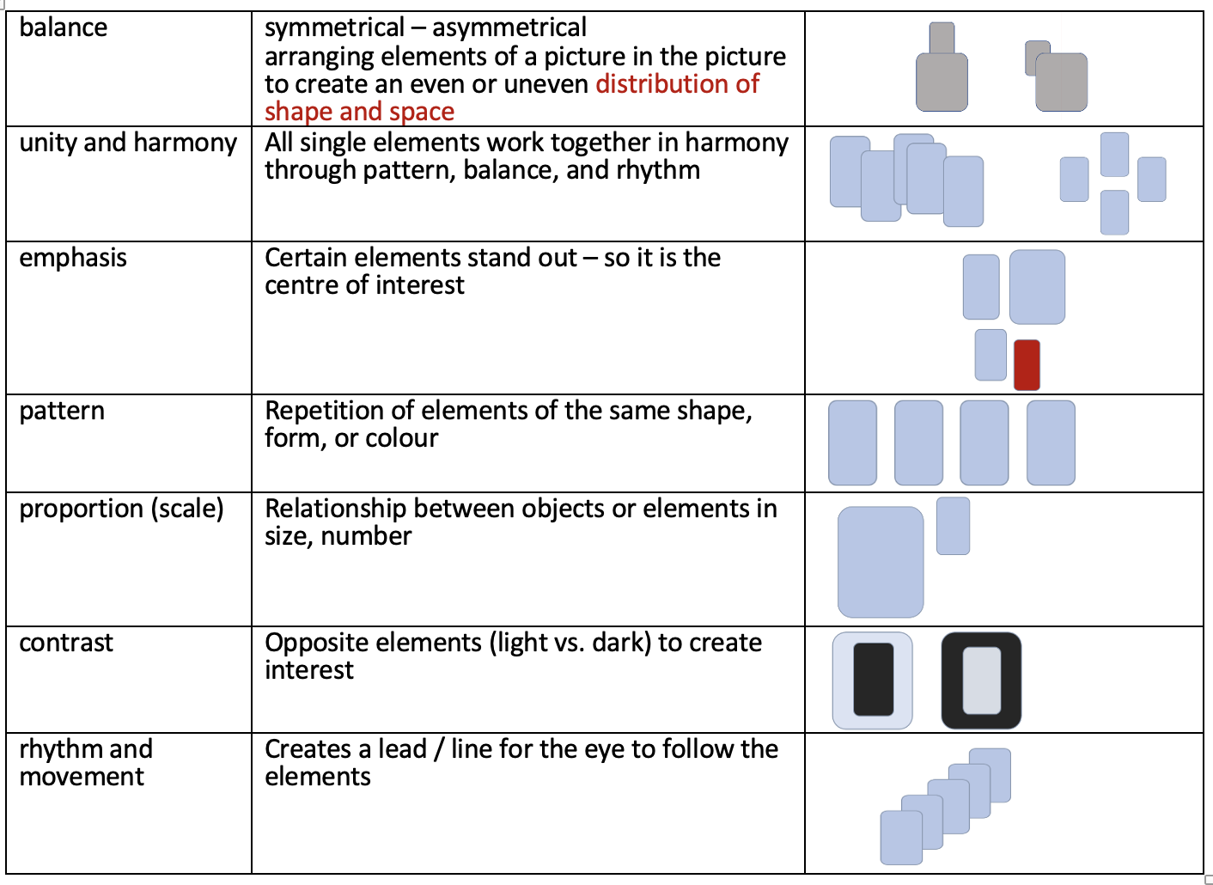
Task 2
Notes:
and now back to our BarCodes

Slide 13





You are going to be a graphic designer!
You have to design a barcode for a product of your choice.
Decide for which product your barcode will be.
Try out ideas in your sketch book.
(bare in mind the principles of design)
You can also change your barcode if you like:
(draw on it, add to it, cut out parts of it or even the whole barcode and rearrange it as you please…)
Careful: Stealing ideas can be very expensive in this business!

Slide 14
No ideas? ...well,
...what could a creative design for a pasta packaging look like?
Or some non food, maybe a drill, shoes...

Slide 15



Assessment criteria
Creative effort, originality of design
Use of at least two compositional principles
(symmetry, asymmetry, repetition, dispersion, clustering)
Clean application and attention to detail
light preliminary sketch, no erasure marks, work with a very thin black felt-tip pen
placement on product is possible

Slide 16
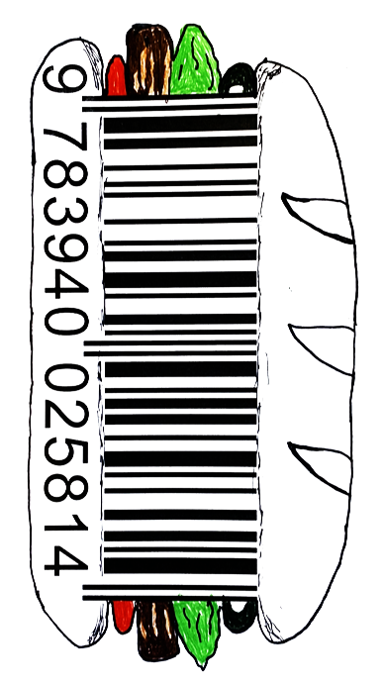
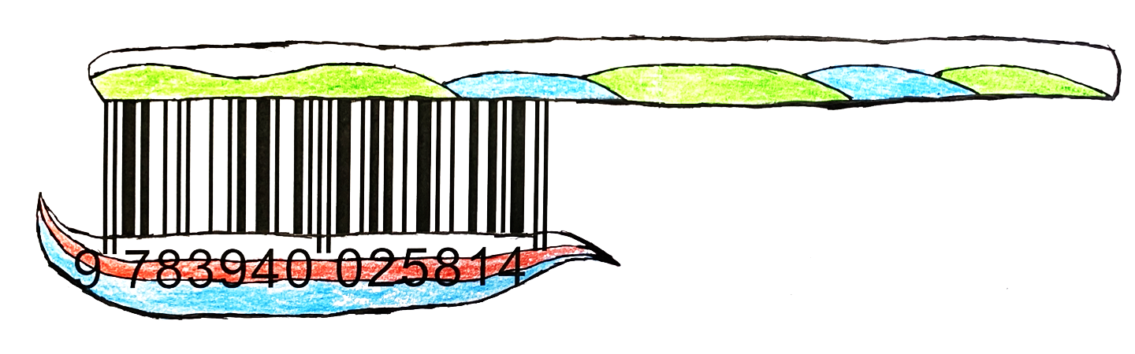
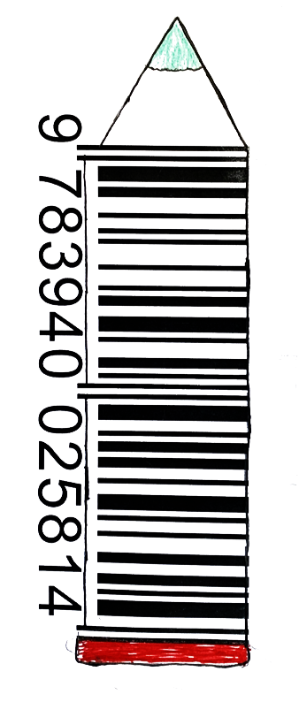
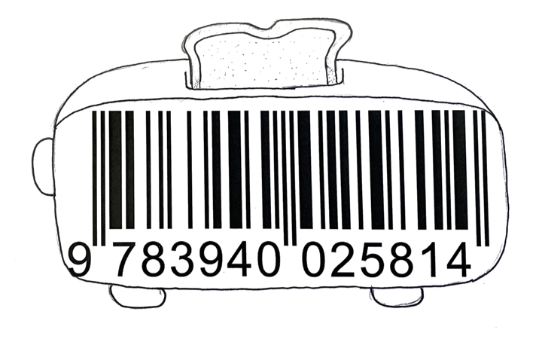
Schülerwerke (RS Neusäß, 7d)

Slide 17
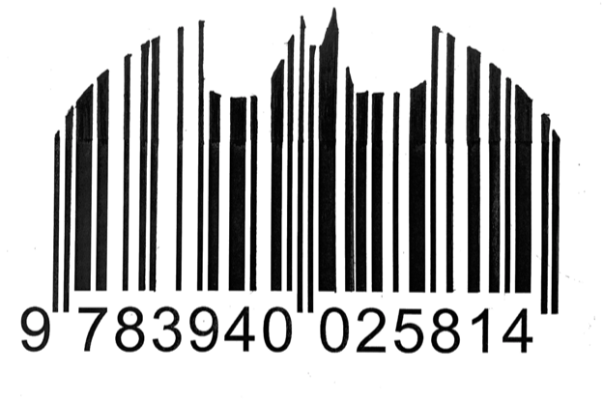
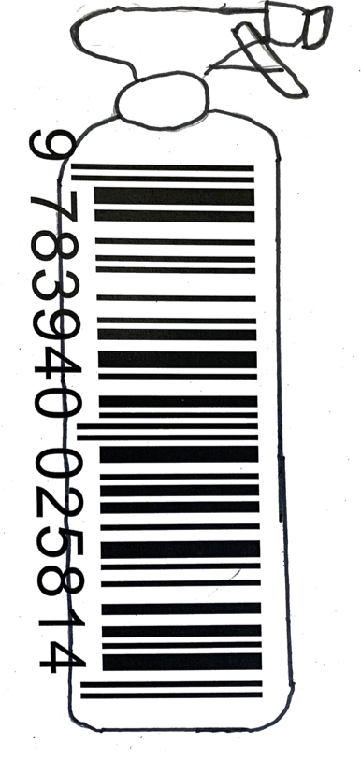
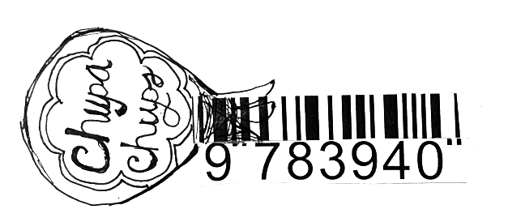
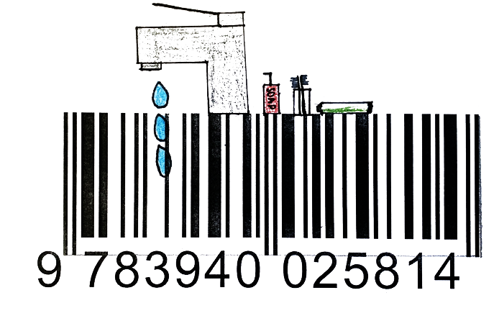
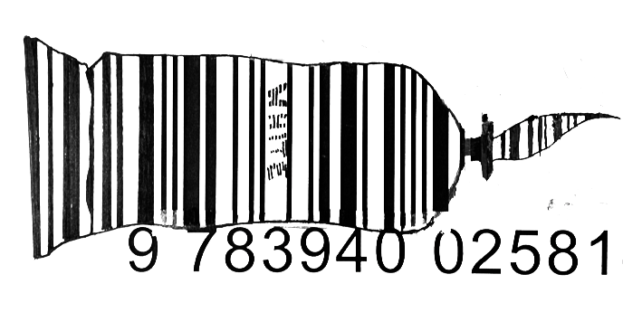

Slide 18
