Slide 1
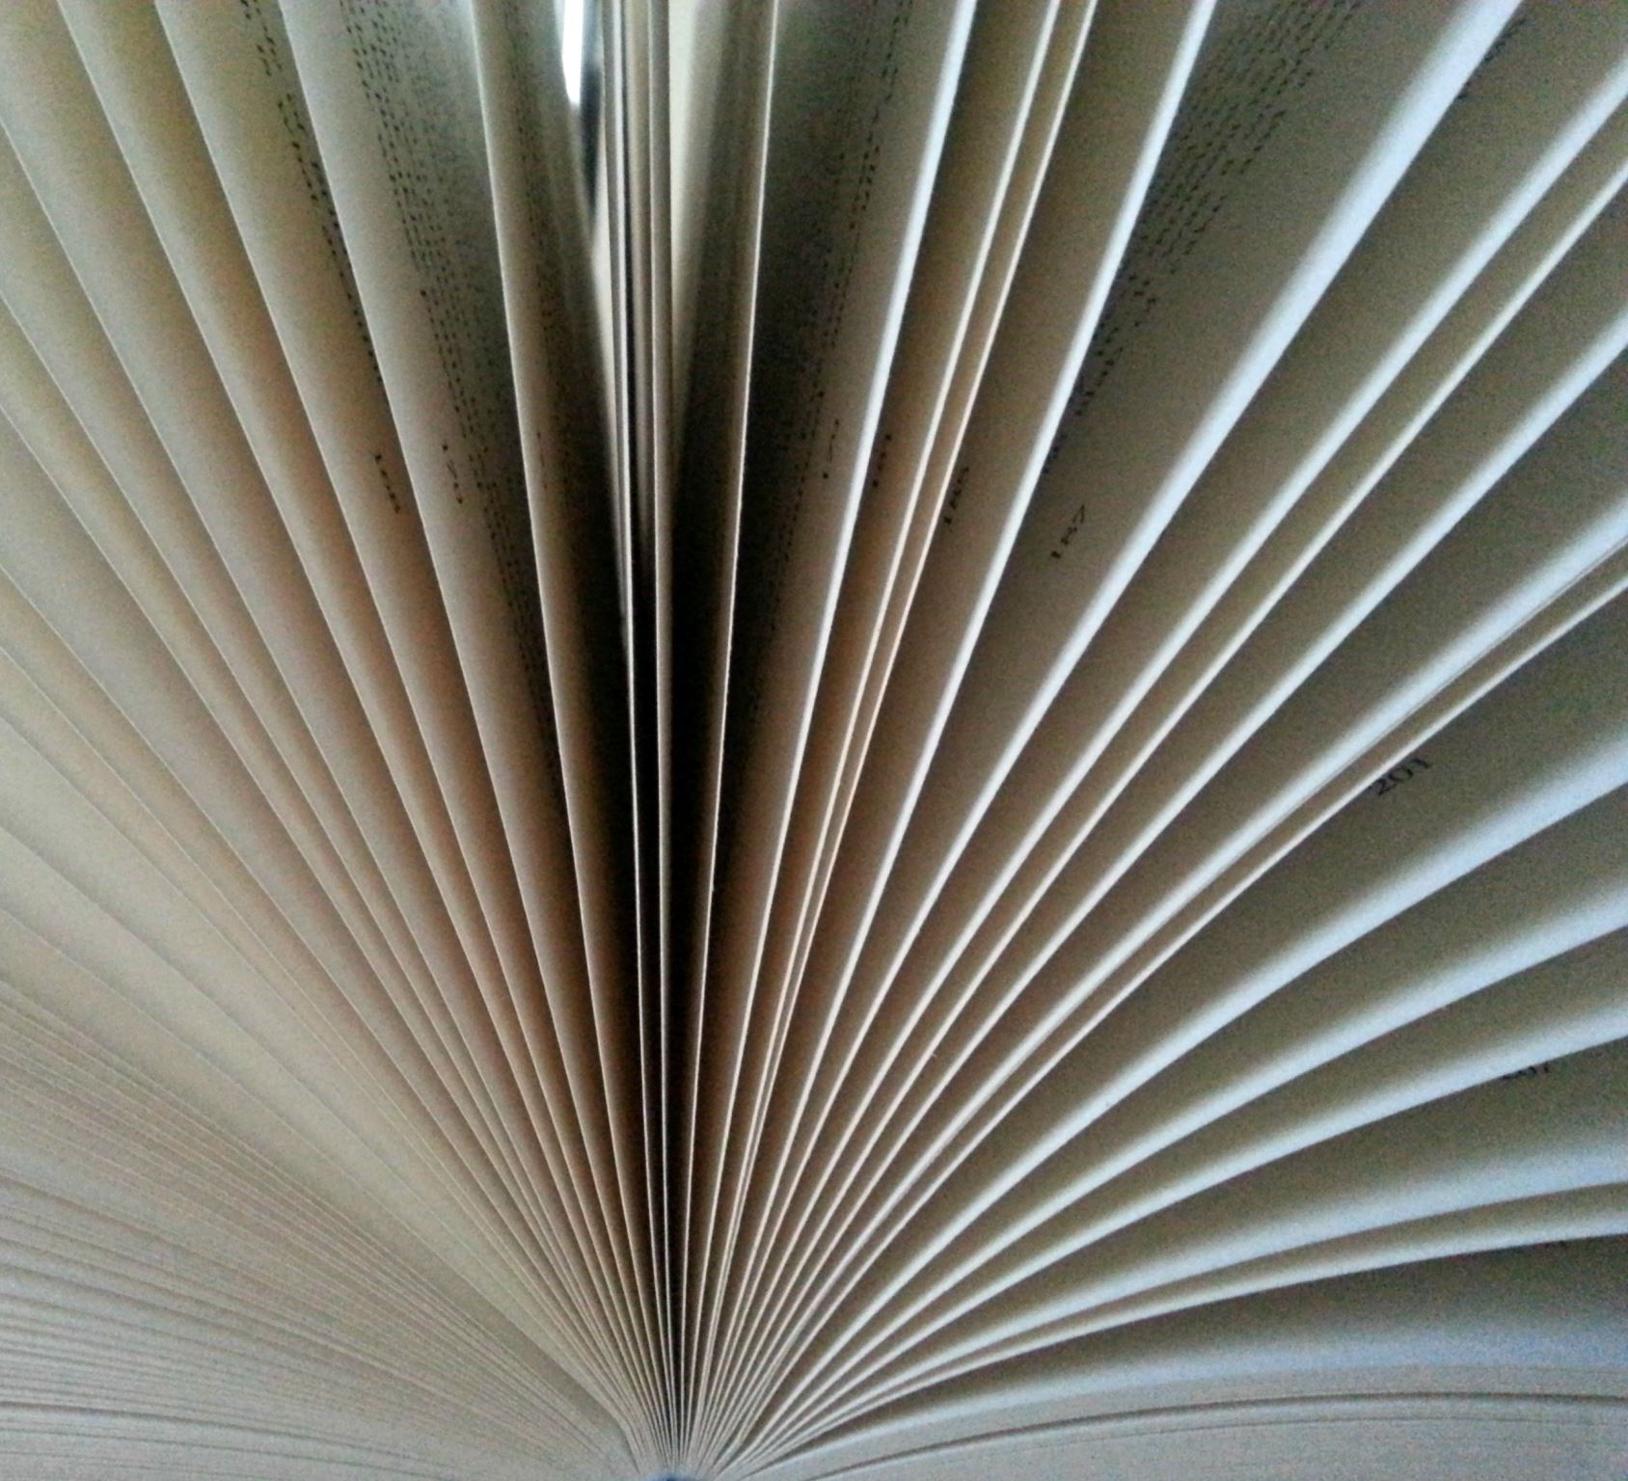
SWATCH-BOOK
Fashion meets its
creator

Slide 2
Check out the world of fashion
Hier GGF. Bilder von Pattern Mix Outfits einfügen

Slide 3
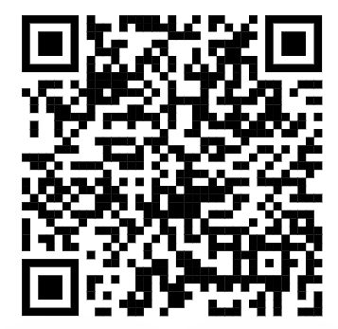
Check out the world of Patterns – part 1
Team up with at least 3 more students and COME AND get a „pattern-set“ FOR YOUR TEAM
Try to match the names of the pattern to the pictures – you will have to introduce them to your fellow pupils and explain your choices
If you have any problems with vocabulary –
feel free to use Online „ALD“

Slide 4
Check out the world of Patterns – part 2
Not only the clothes but also the pattern can create the Look – which pattern would be good for
An Elegant Outfit (evening Dress, Wedding, theater)
A Casual outfit (shopping, leisure time, cinema)
A Business outfit (office, Work, Meeting)
A Formal outfit ( e.g Suit, pencil skirt, blouse, )

Slide 5
REMEMBER TEXTURE?
CLOTHES ARE MADE OF FABRIC – WE USE DIFFERENT MATERIALs TO CREATE FABRIC
DIFFERENT MATERIALS / FABRICS HAve DIFFERENT TEXTUREs
BRAINSTROM IN YOUR TEAM – WHICH MATERIALS / FABRICS DO YOU KNOW
THINK „TROUSERS / SCARF / JUMPER / COAT…“
Do you know / remember words to describe the texture / surface of these materials

Slide 6
ichy velvety silky fleecy dull
WORDS TO DESCRIBE FABRIC
Rough
scratchy
fluffy
woolly
smooth
shiny
soft
like when you got stung by a bee
like the surface of a peach
like shiny hair
like the cuddly fleece jumper
the opposite of shiny
like the surface of a rock
gives you an itchy feeling
that‘s what clouds must feel like
feels like Shaun (the Sheep)
like freshly brushed teeth

Slide 7
The swatch book project
What is a swatch?
A swatch is a small piece of cloth/ fabric used to show people what a larger piece would look or feel like
2. What is a swatch book?
A Swatch book is a book full of different swatches

Slide 8
The swatch book project
How to go about it
Choose an outfit you like from one of the fashion magazines – careful; it must be an outfit with patterns of some sort
Cut out the picture and stick it on the left-hand side of A4 Paper
Now, create at least three different „swatches“ by drawing the patterns of the outfit in 70 x 70 mm-sized-boxes next to your „Model“ – Try to capture the right colours, Shades and texture of the fabric in your swatch.

Slide 9
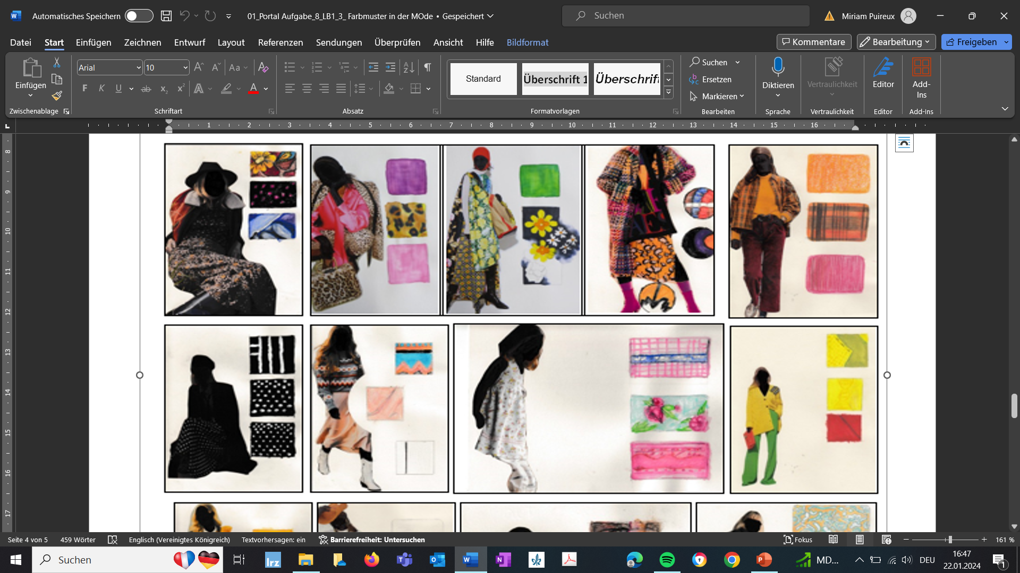
The swatch book project
assessment criteria
Colouring and texture of the swatch match the original fabric – almost impossible to tell the difference ;-)
at least three different kinds of pattern / swatches
Here are some examples:

