Slide 1
Make it happen - bilingualer Unterricht im Fach Geographie
Realschule Bayern
27.01.25 Stefanie Hartl

Slide 2
Make it happen – bilingualer Unterricht im Fach Geographie
Analoge Unterrichtsideen
1.1 Planspiel zum Thema child labor
1.2 Contribution Cards
1.3 Irreversible Binomials
1.4 Gallery Walk
1.5 Lernjob Sao Paulo
Digitale Unterrichtsideen
2.1 Fakewhats.com
2.2 Zeoob.com
2.3 Methode Dictogloss
3. Fragen, Wünsche, Anregungen
Notes:
A) Grundlagen der Bewertung von Schreiben
B) Ausgangsbasis Entwicklungsprozess
Neuerungen
Bewertungskriterien
Begleitmaterialien
c) Praxisteil: schreiben – bewerten – auswerten (Google Statistik Tool)
D) Gelegenheit zu Fragen und Gesprächen

Slide 3
Make it happen – bilingualer Unterricht im Fach Geographie
1. Analoge Unterrichtsideen
1.1 Planspiel zum Thema Child Labor
Gründe für den Einsatz von Planspielen im Unterricht:
Verbinden der Lebenswirklichkeit mit spielerischem Agieren
Bearbeitung und Analysieren von globalen Problemen oder Konflikten
Aufzeigen von Ideen für die Änderung von Einstellungen und Verhaltensweisen
Schulung von Empathie Fähigkeit
Einüben neuer Verhaltensweisen

Slide 4
Make it happen – bilingualer Unterricht im Fach Geographie
1.1 Planspiel zum Thema Child Labor
Methodische Hinweise zum Planspiel:
1. (Gemeinsames) Durchlesen der Rollen
2. Festlegen der unterschiedlichen Rollen in den Gruppen
→Finden von Argumenten
3. Gemeinsames Planspiel innerhalb des definierten Zeitrahmens, einzelne Charaktere stellen ihren Standpunkt dar. Diskussion oder Verhandlungsrunde und Finden einer gemeinsamen Lösung.
Akustisches Signal für Start und Ende des Planspiels (z.B. Glocke)
4. Auswertung und Besprechung des Planspiels und Diskussion von Lösungsansätzen

Slide 5
Make it happen – bilingualer Unterricht im Fach Geographie
1.1 Planspiel zum Thema Child Labor
Read all the statements and choose a person you are able to identify with.
Amar, owner of a company that produces fireworks
"Of course, as an employer, I also employ children in my company. They are diligent and skilled workers, and I don't have to pay them as much as my adult employees. This way, I can ensure the survival of my business by saving on labor costs. Many tasks can be done much better by children because they are smaller. If I didn't employ children, families would also have less money available. Therefore, all parties benefit from child labor."
Timothy, human rights activist
"Child labor must be globally banned and not tolerated in any country. This is what I, as an employee in a human rights organization, demand. While the additional income may be important for families, it is short-sighted. The lack of education prevents children from taking part in social life, and people are trapped in the cycle of poverty. Therefore, we demand fair wages for all workers. If we were willing to pay a little more for products from these countries, we could help them.”
Amrit, working child
"As a child, I spend most of my day at the workplace. There is no time left for school. But I am proud that I can help my family, so we have a little more money available. Sometimes it would be nice to have more free time to play with my friends. But this way, I am already learning a lot in my job, which will give me an advantage when I grow up. A trade union that represents the rights of us working children is very helpful. However, we still remain children with fewer rights.

Slide 6
Make it happen – bilingualer Unterricht im Fach Geographie
1.1 Planspiel zum Thema Child Labor
Read all the statements and choose a person you are able to identify with.
Inika and Jamal, parents
"As parents, it breaks our hearts that our child has little time to play because they have to spend almost the entire day at their workplace. But without the additional income, we simply wouldn't be able to survive, so we all help together to make our modest life possible. Sending our child to school is not possible because there is no time left after work, and we cannot afford notebooks, textbooks, and pens at all. So, together, we lead a simple life."
Anna, loves to celebrate New Year’s Eve
On New Year's Eve, we always meet our friends and celebrate together. We always have dinner at home and play card games. Of course, both children and adults love the fireworks at the turn of the year. I always tell my husband not to spend too much money on fireworks, but we still want to see the brightly lit sky. It’s part of our tradition.
Samira, teacher
"I am a teacher in a small village, teaching at the school here. Unfortunately, only a few children attend the classes because they have to work. A solid education would make it easier for the children to get better-paid jobs in the future. However, this is denied to them because without learning how to read, write, and do math, they will always end up with simple and poorly paid jobs."

Slide 7
Make it happen – bilingualer Unterricht im Fach Geographie
1.2 Contribution Cards
Geeignet für Diskussionen/ Austausch in der Gruppe (3-4 Schüler)
Jede Schülerin/ jeder Schüler erhält 3-4 Karten
Nach jeder Äußerung legt man eine Karte in die Mitte
Ziel: Jeder trägt die gleiche Anzahl an Äußerung zum Gespräch bei
In jeder Jahrgangsstufe einsetzbar
Beispiel: What do you already know about China? → Facts
Beispiel: Why do so many children have to work? → Opinions
→ Get active!

Slide 8
Make it happen – bilingualer Unterricht im Fach Geographie
1.3 Irreversible Binomials
Methode, um Schülern einen neuen Partner zuzuweisen
Jede Schülerin/ jeder Schüler erhält 1 Wortkärtchen
Immer zwei Wörter gehören zusammen, auch als Dreiergruppe möglich
Schüler suchen nun aktiv nach dem richtigen Partner
Mobilisierung von Vorwissen
Dauer: ca. 10 Minuten
Beispiel: British - colony // West Ghats – East Ghats // …
→ Get active!

Slide 9
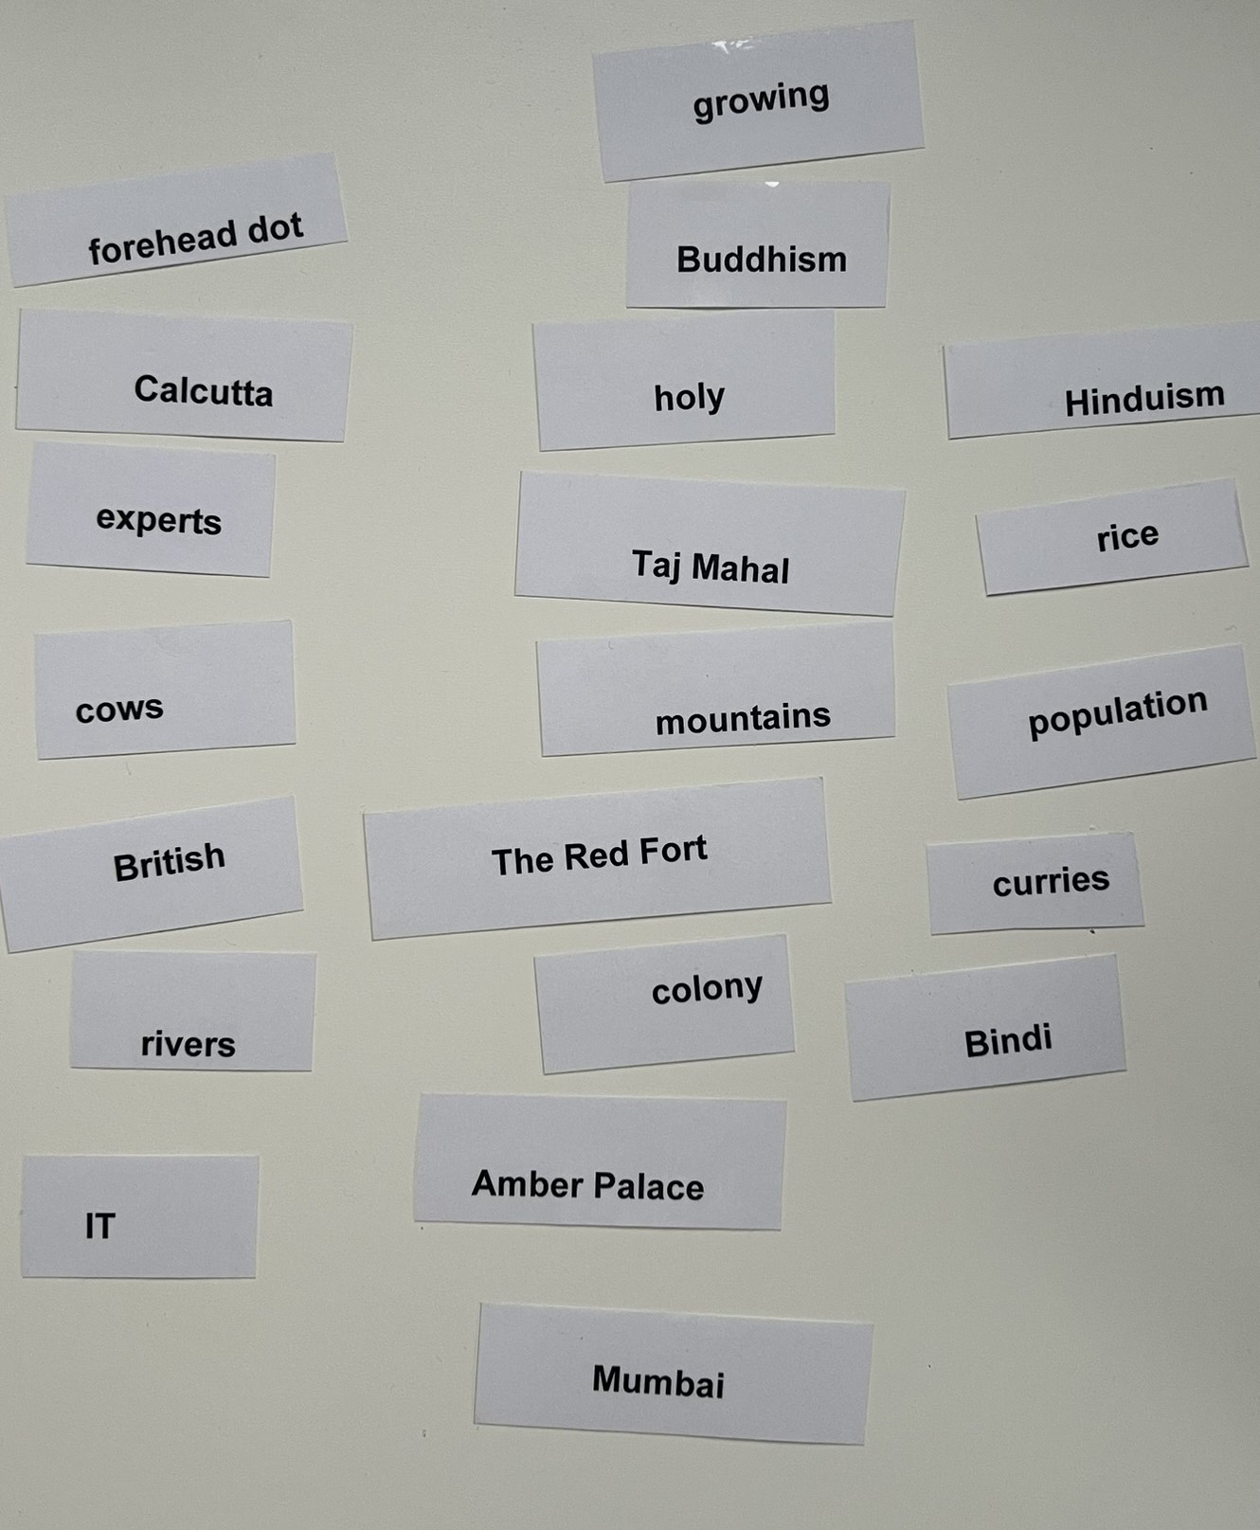
Make it happen – bilingualer Unterricht im Fach Geographie
1.3 Irreversible Binomials
Beispiel zum Thema Indien
Partnerzuteilung vor Atlasarbeit

Slide 10
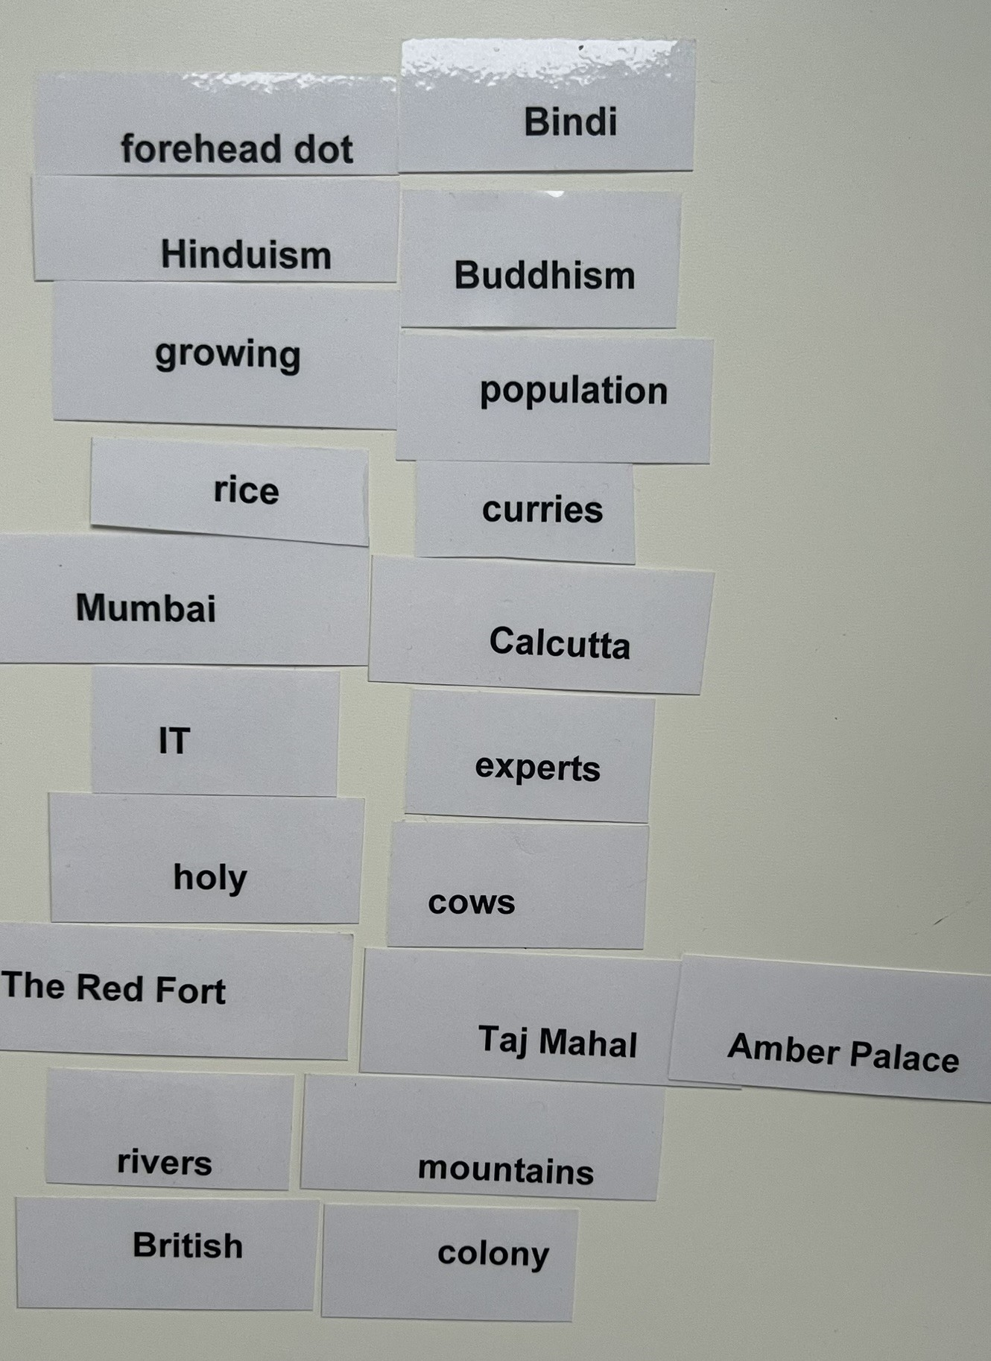
Make it happen – bilingualer Unterricht im Fach Geographie
1.3 Irreversible Binomials
Lösung:

Slide 11
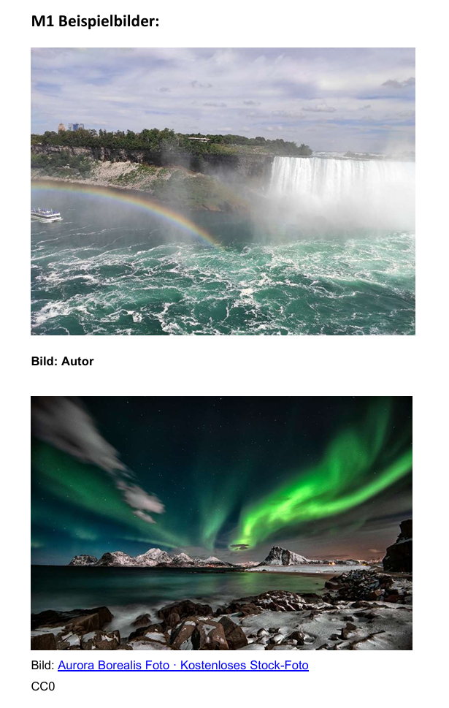
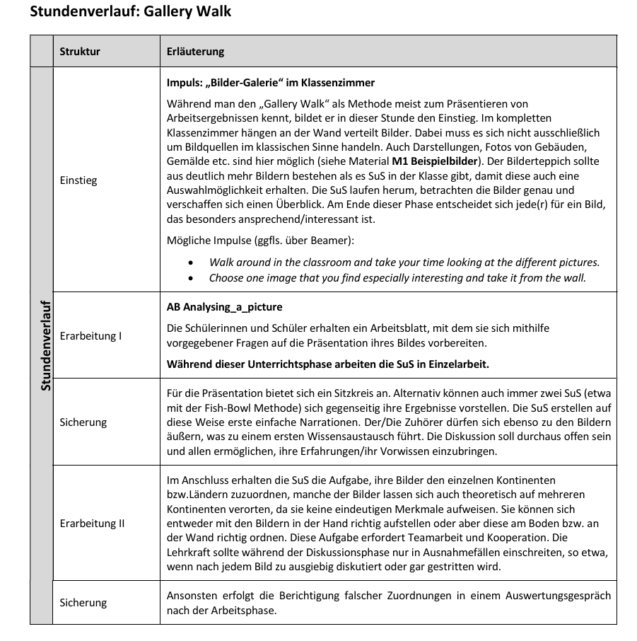
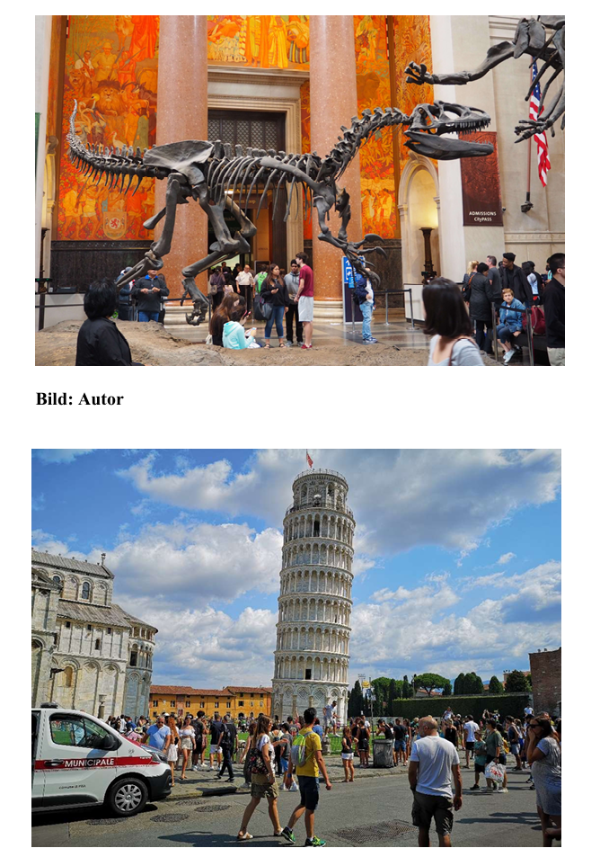
1.4 Schnupperstunde Gallery Walk
Bild: Autor

Slide 12
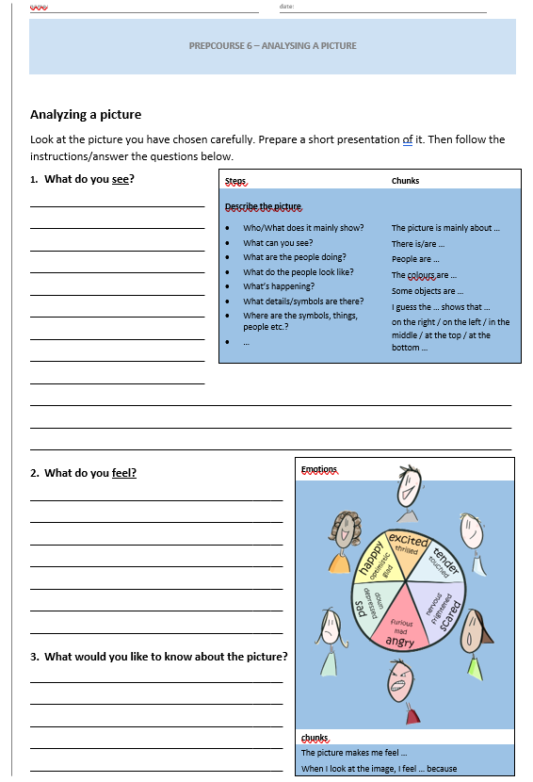
1.4 Schnupperstunde Gallery Walk

Slide 13
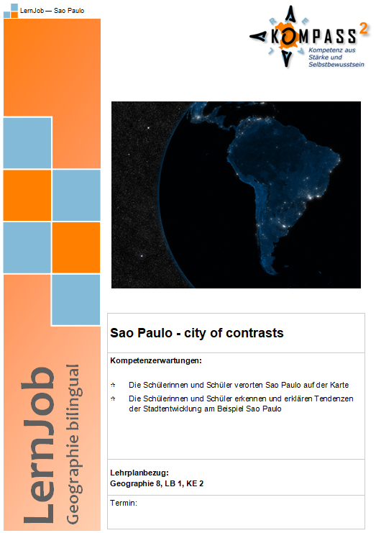
Make it happen – bilingualer Unterricht im Fach Geographie
1.5 Lernjob Sao Paulo
© ISB

Slide 14
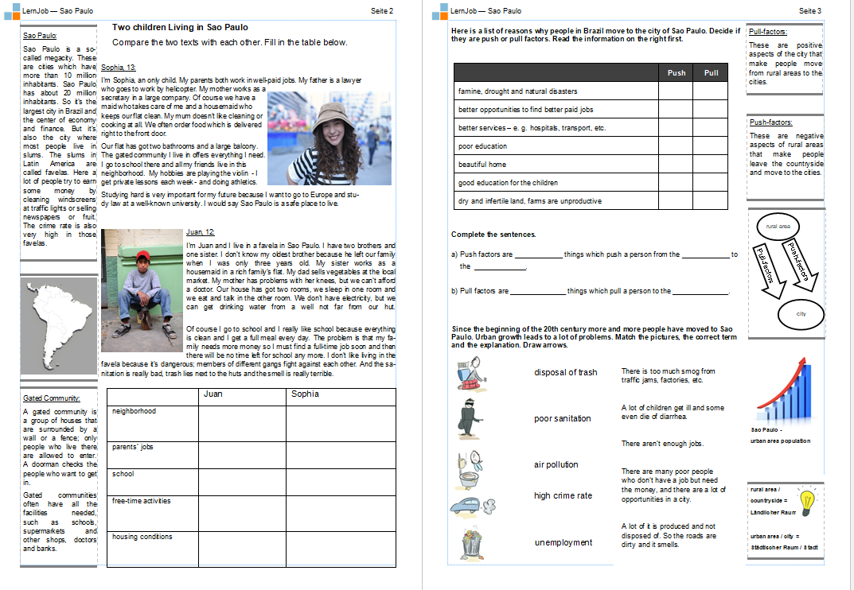
Make it happen – bilingualer Unterricht im Fach Geographie
1.5 Lernjob Sao Paulo
© ISB

Slide 15
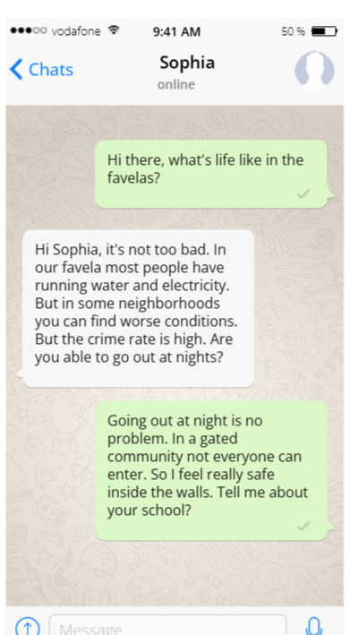
Make it happen – bilingualer Unterricht im Fach Geographie
2. Digitale Unterrichtsideen
2.1 Fakewhats.com
Kostenlos und ohne Anmeldung
Zu jedem Thema anwendbar
Zur Ergebnissicherung
Kann bewertet werden

Slide 16
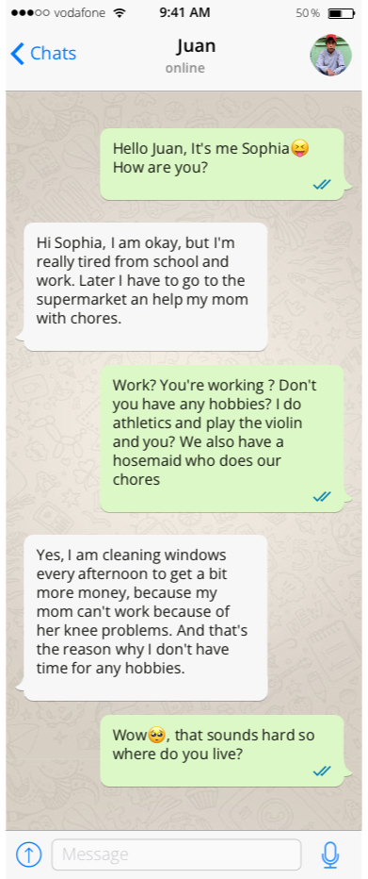
Make it happen – bilingualer Unterricht im Fach Geographie
2.1 Fakewhats.com

Slide 17
Make it happen – bilingualer Unterricht im Fach Geographie
2.1 Fakewhats.com

Slide 18
Make it happen – bilingualer Unterricht im Fach Geographie
2.1 Fakewhats.com

Slide 19
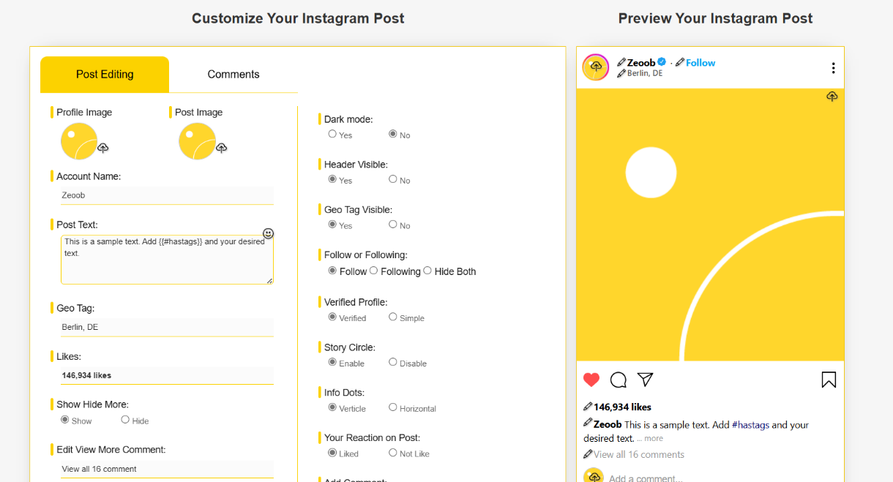
Make it happen – bilingualer Unterricht im Fach Geographie
2.2 Zeoob: Instagram Posts
Beispiel: Living in a favela / gated community
Profilbild / gepostete Bilder zur Besprechung von richtiger Bildersuche (Urheberrecht, Recht am eigenen Bild) verwendbar
Kann auch bewertet werden

Slide 20
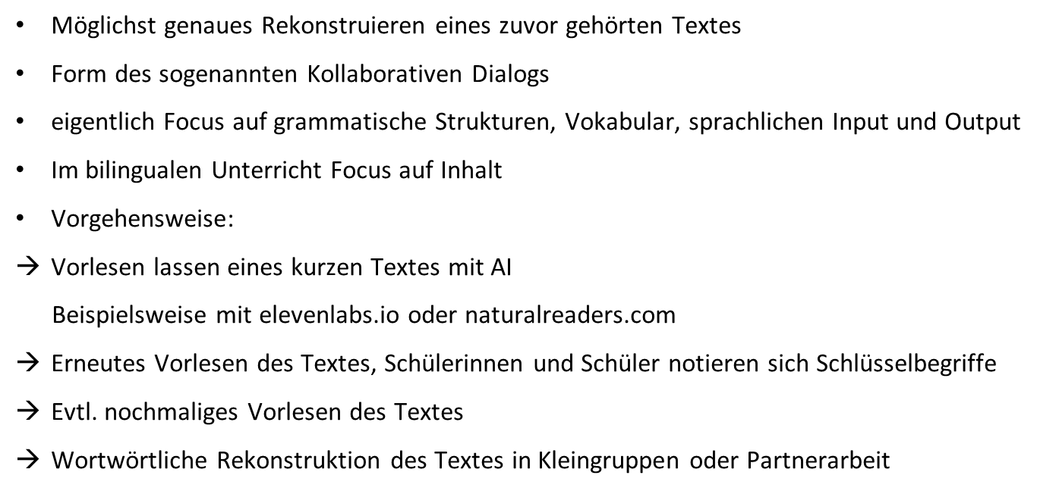
Make it happen – bilingualer Unterricht im Fach Geographie
2.3 Methode Dictogloss

Slide 21
Make it happen – bilingualer Unterricht im Fach Geographie
2.3 Methode Dictogloss
Einsatzmöglichkeiten im bilingualen Unterricht:
Banana – a cash crop from Costa Rica
Globalization – what does this term mean?
Plate tectonics

Slide 22
Make it happen – bilingualer Unterricht im Fach Geographie
2.3 Methode Dictogloss
CHINA – an economic superpower
China is the world’s largest exporter, because it produces goods like toys, computers, electric cars (such as BYD), and mobile phones. Until 1978, it had a planned economy where the government controlled production, prices and jobs. Back then it was one of the poorest nations.
In the 1980s, China changed to a market economy, introducing new technologies and production methods. The biggest boost was that foreign companies were allowed to invest and produce their goods in China. Attracted by low wages, cheap land, a large consumer market, and low taxes a lot of international companies started their production here. These companies brought advanced technology and management expertise.
China’s economic boom has transformed urban areas. You can find improved living standards, modern skyscrapers, and shopping centers in the cities.

Slide 23
Fragen, Wünsche, Anregungen?

Slide 24
Vielen Dank für Ihre Aufmerksamkeit!
StRin Stefanie Hartl
Arbeitskreis Bilingual am ISB Stefanie.Hartl2@schule.bayern.de

